Slide 1
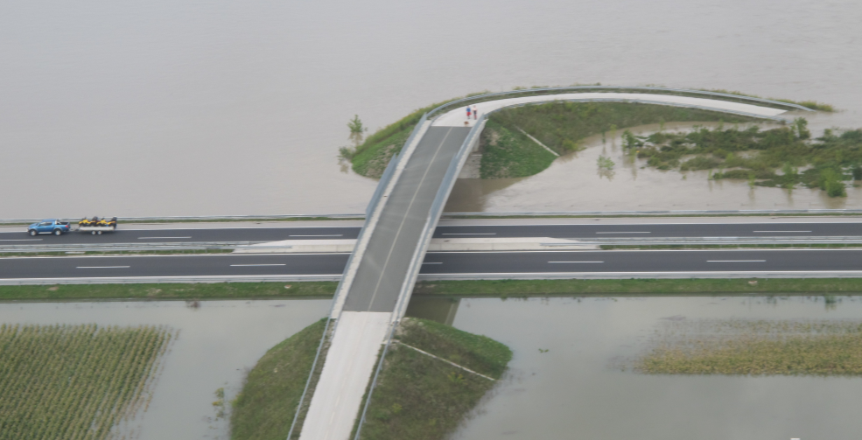
Flood and Drought Risk Management in the Danube River Basin

Slide 2
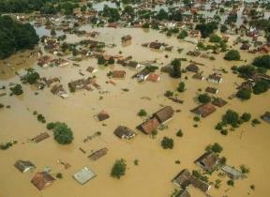
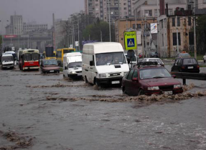
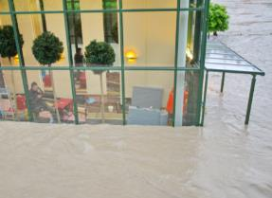
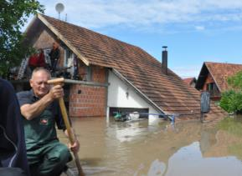
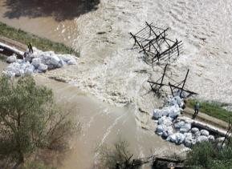
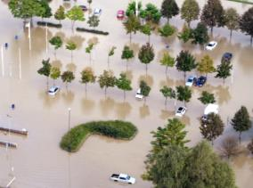
Recent major flood events
C. Weinberger, Ach
2002
2005
2006 0.6x10⁹ €
2010 2x10⁹ €
2013 2.4 x10⁹ €
2014 3.8 x10⁹ €
2023 10x10⁹ €
ISRBC
Zsófia Kugler - BME
Zsófia Kugler - BME

Slide 3
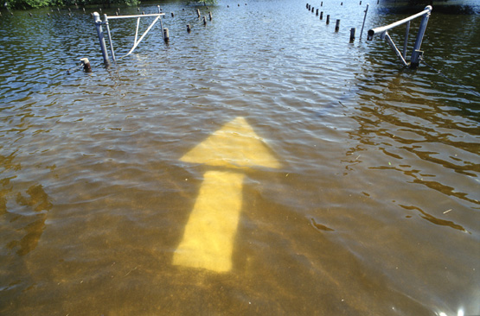
ICPDR response to floods: Flood Action Programme
Action Programme on Sustainable Flood Protection in the Danube River Basin adopted in 2004

Slide 4
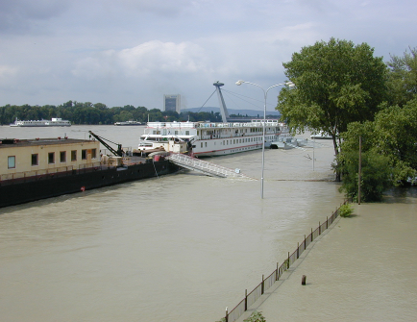
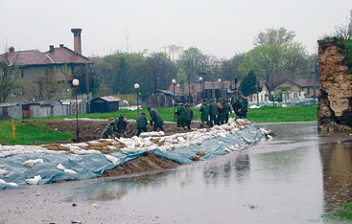
Action plans for sub-basins
17 flood action plans for the sub-basins prepared in 2009;
First comprehensive overview of hundreds of measures to reduce flood risks ever prepared in DRB.

Slide 5
EU Floods Directive
Three steps of flood risk management:
Preliminary flood risk assessment (2011/2018/2024)
Flood risk and flood hazard maps (2013/2019/2025);
Flood risk management plans (2015/2021/2027).

Slide 6
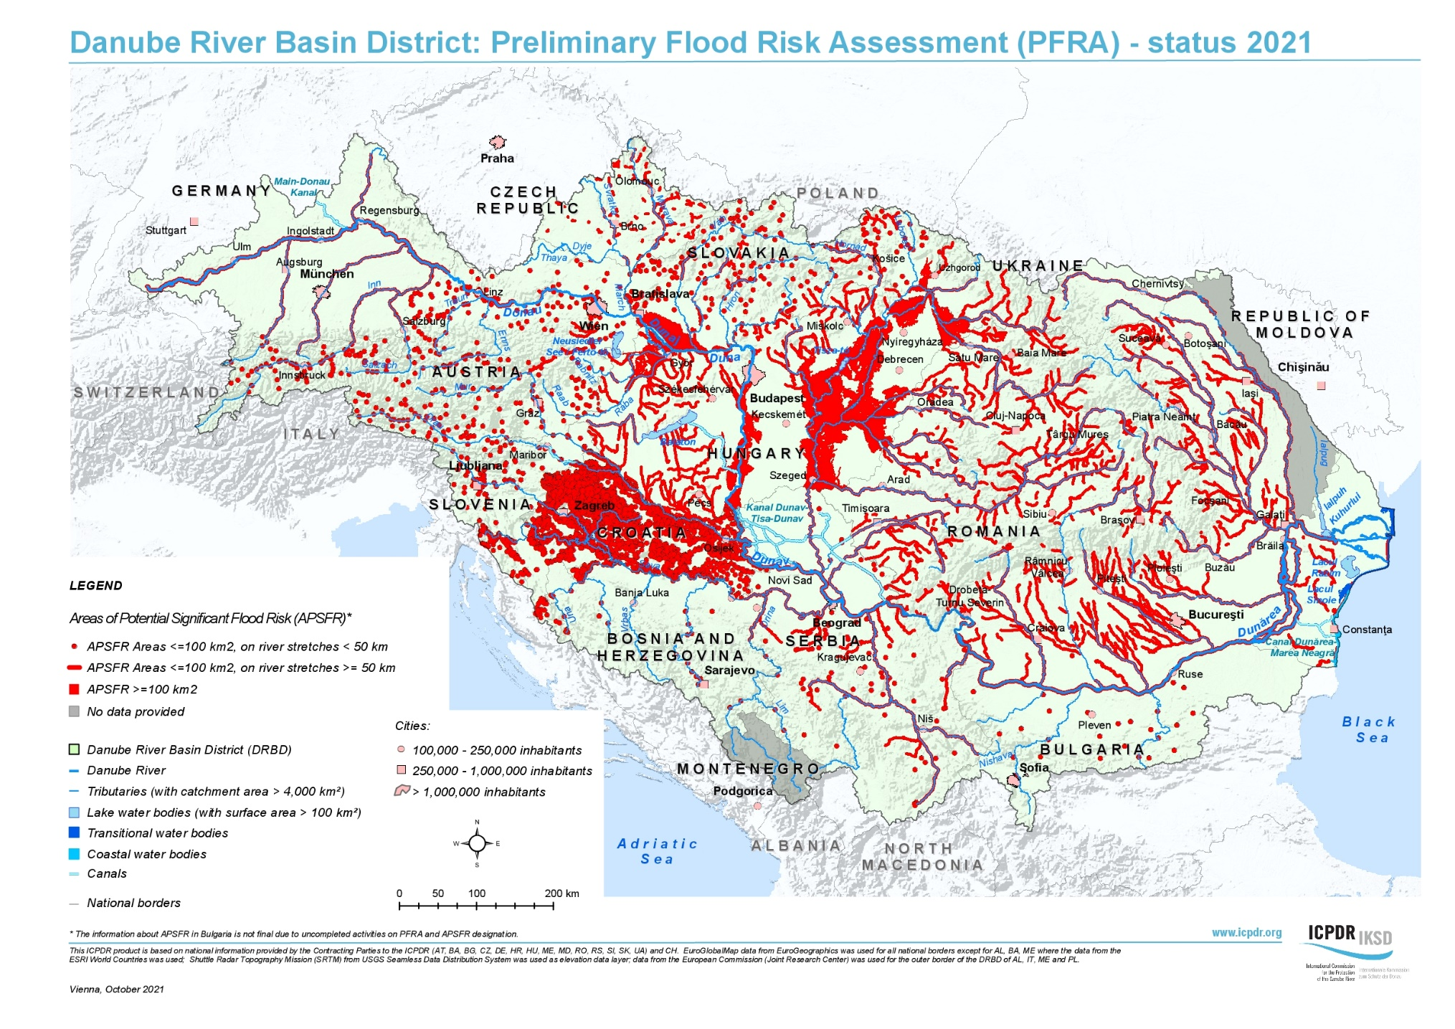
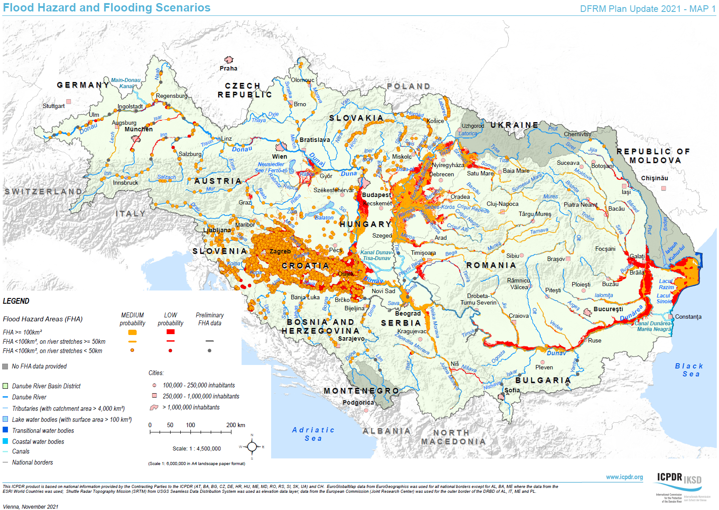
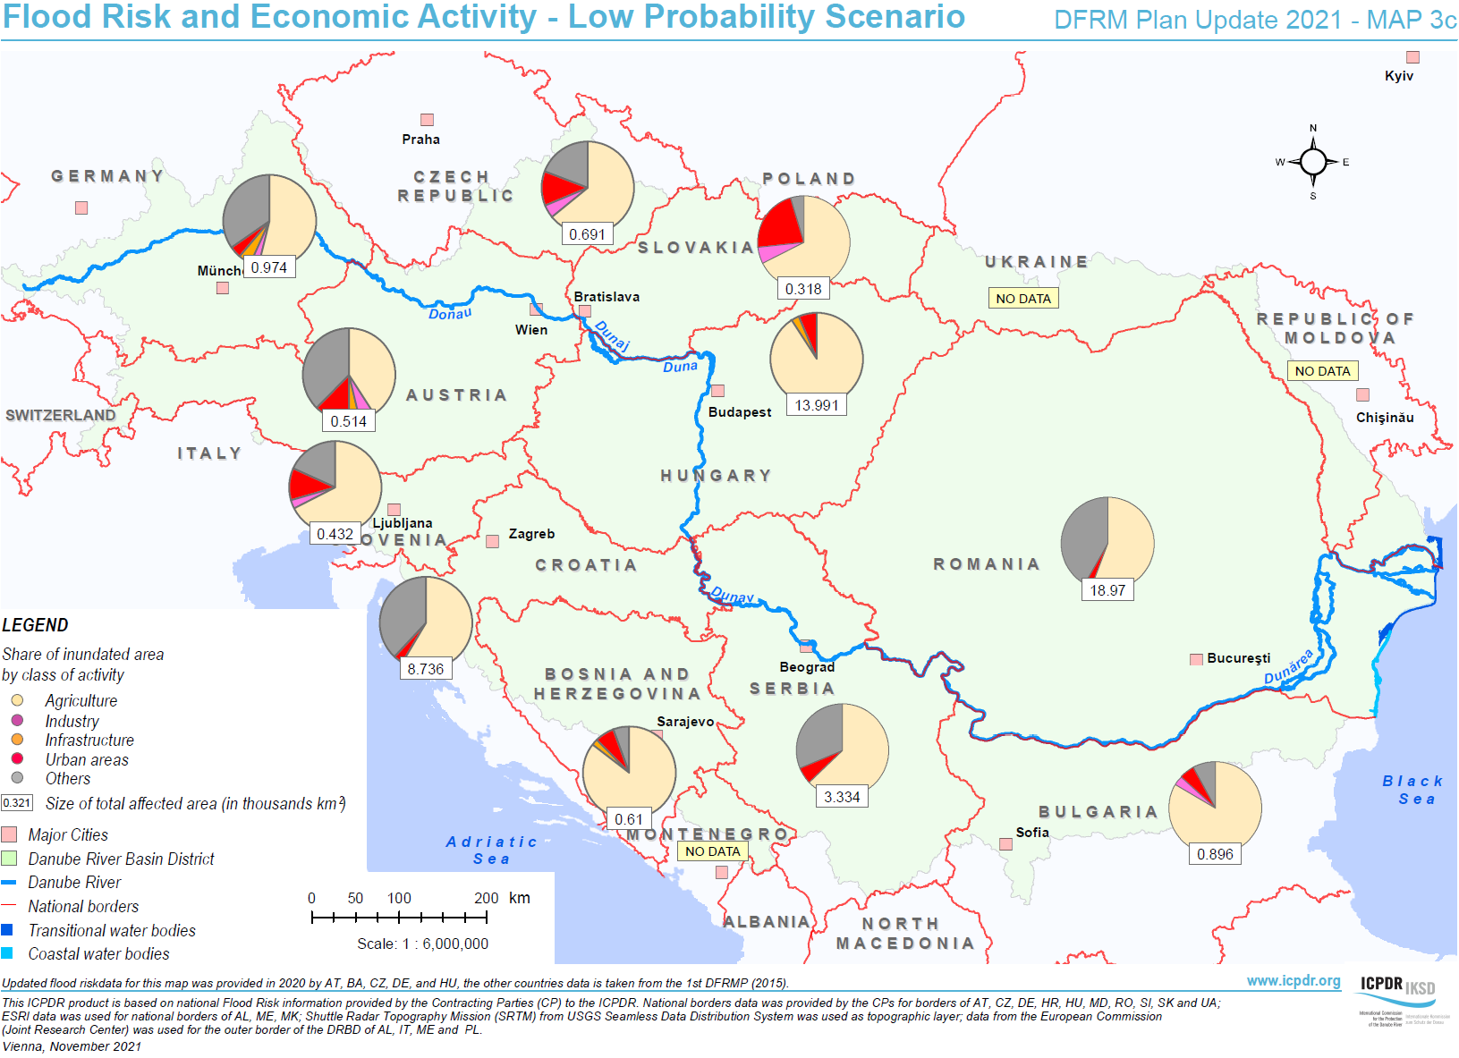
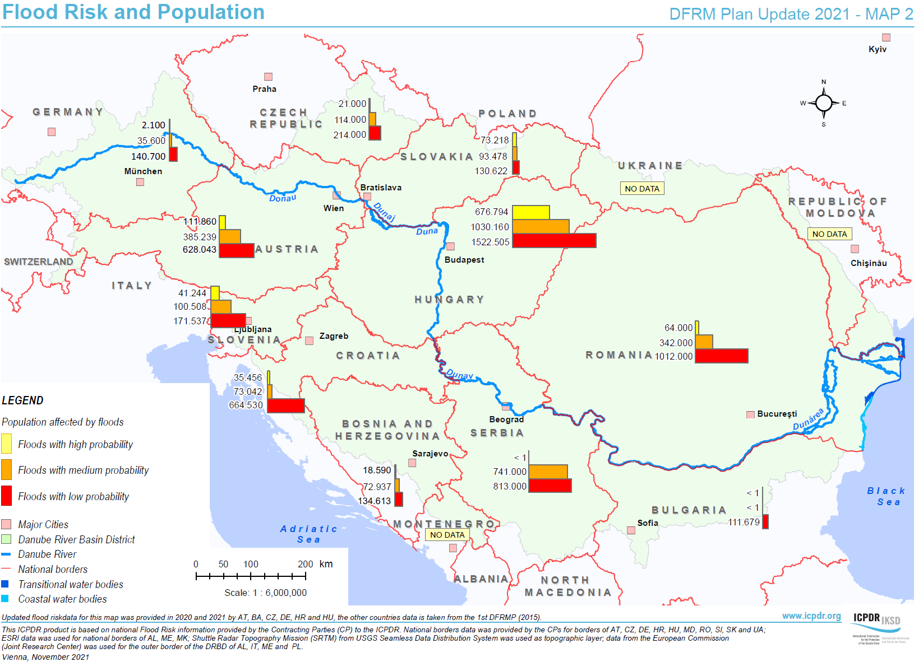
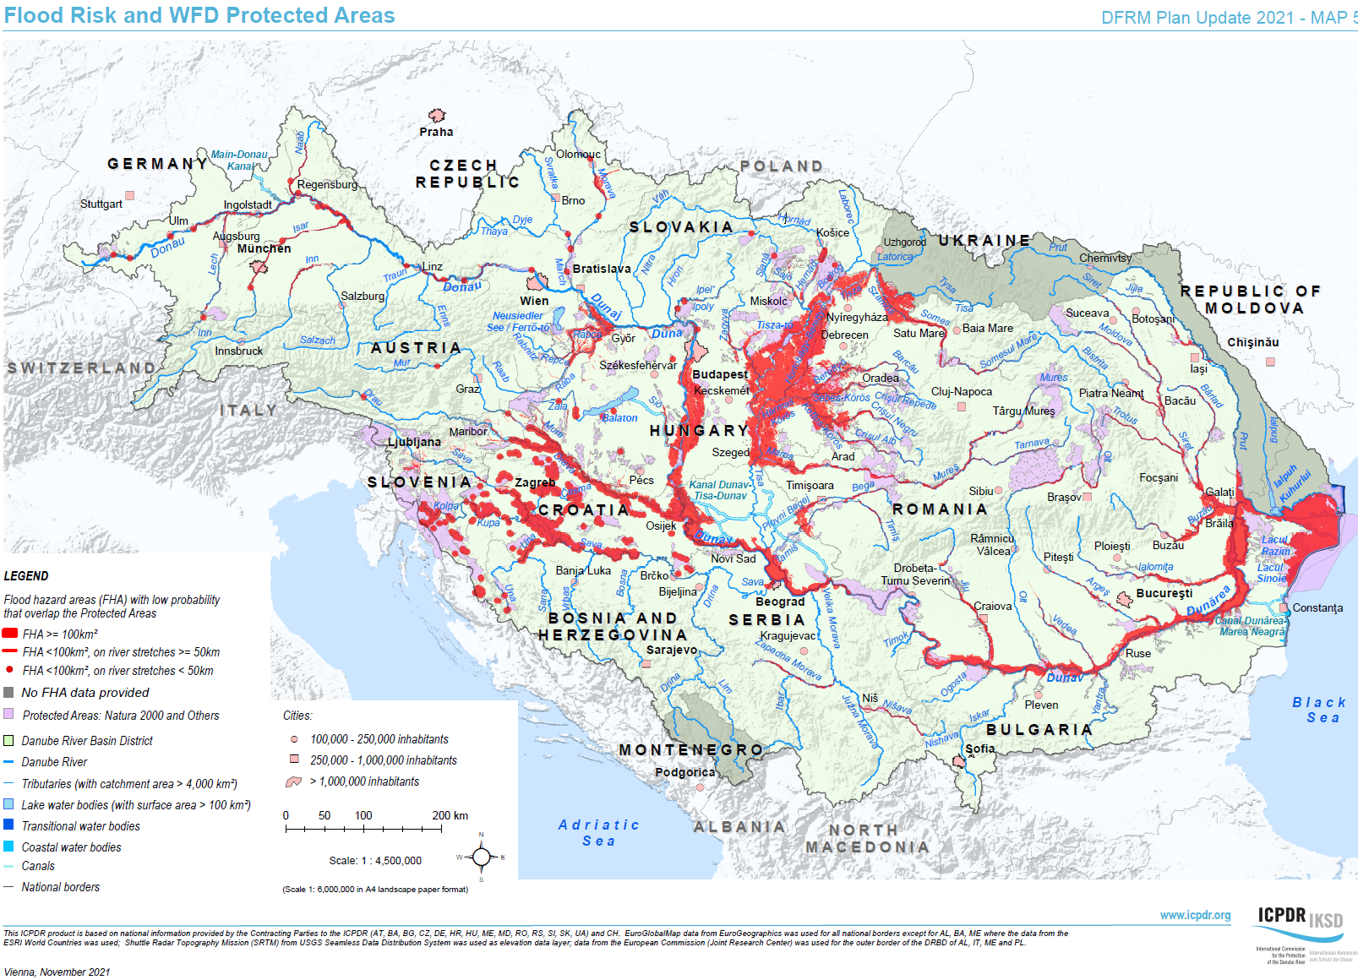
PFRA & hazard and risk maps

Slide 7
Danube Flood Risk Management Plan – Update 2021
Introduction
Conclusions of the preliminary flood risk assessment
Conclusions on flood hazard maps and flood risk maps
Objectives
Measures and their prioritisation
Water retention
Coordination with WFD
Cost-benefit analysis
Impacts of climate change
International coordination
Promoting the solidarity principle
Public information and consultation
Conclusions and next steps.

Slide 8
FRMP – agreeing objectives
Basin-wide objectives of DFRMP - they are linked to the respective measures and reconfirmed for 2021:
Avoidance of new risks
Reduction of existing risks
Strengthening resilience
Raising awareness
Solidarity principle

Slide 9
Annex 2: Measures & projects supporting DFRMP
Strategic level measures: Measures with downstream effect and measures applicable in more countries of the basin
natural water retention,
warning systems,
awareness rising,
reduction of risk from contaminated sites in floodplain areas.
Projects & project ideas identified by FP EG:
Reflect the objectives and priorities set in DFRMP.
Basin-wide / transboundary character.

Slide 10
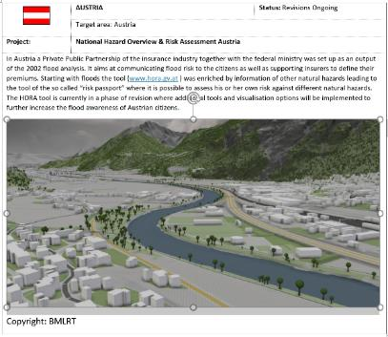
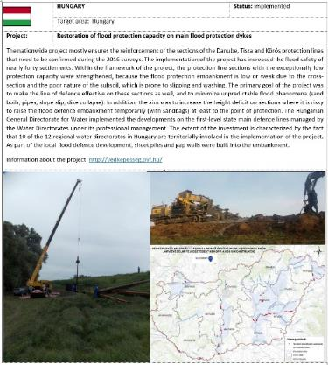
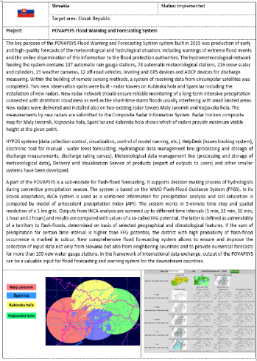
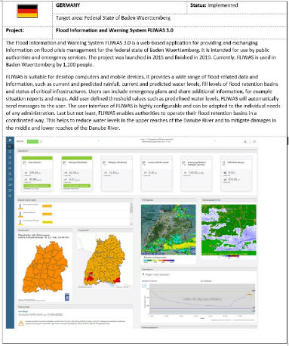
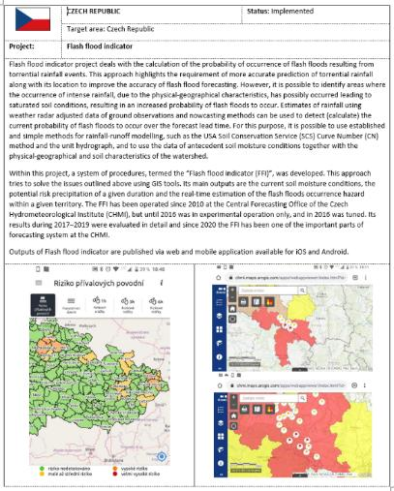
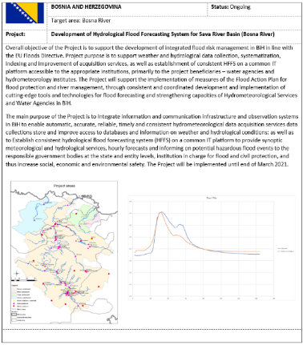
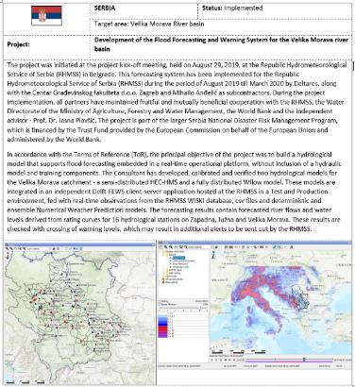
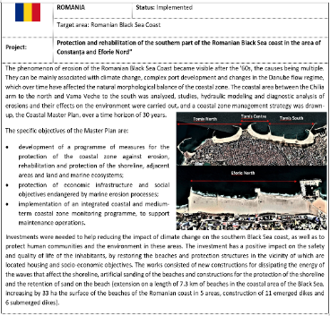
Best practice examples

Slide 11
Coordination with WFD
Emphasis on integrated approaches
Focus on natural water retention measures
ICPDR Discussion paper

Slide 12
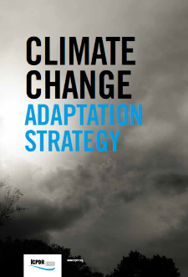
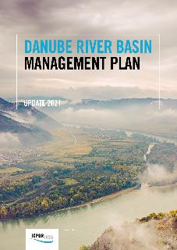
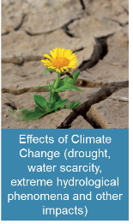
Basin-Wide Response to Climate Change
Addressing climate change adaptation with a basin-wide strategy:
Guiding how to integrate adaptation into overall ICPDR planning
Relevant actions incorporated in the DRBMP and DFRMP
Supporting transboundary actions and feeding into national strategies
Toolbox of potential adaptation measures
Effects of Climate Change reflected in the last management plan:
Declared as a Significant Water Management Issue
Assess possible/additional negative impacts (pressures)
Consider affected water uses in the DRB
Identify possible adaptation measures/actions

Slide 13
DFRMP Public consultation
Public consultation 04-09/2021
http://icpdr.org/main/public-consultation-draft-river-basin-and-flood-risk-management-plans-2021

Slide 14
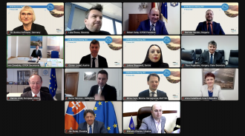
4th ICPDR Ministerial Meeting, 8 February 2022
Ministers and Minister Representatives responsible for water management from the Danube River Basin countries and the European Union endorsed the Danube River Basin Management Plan and Danube Flood Risk Management Plan Updates 2021 and adopted a ministerial “Danube Declaration”

Slide 15
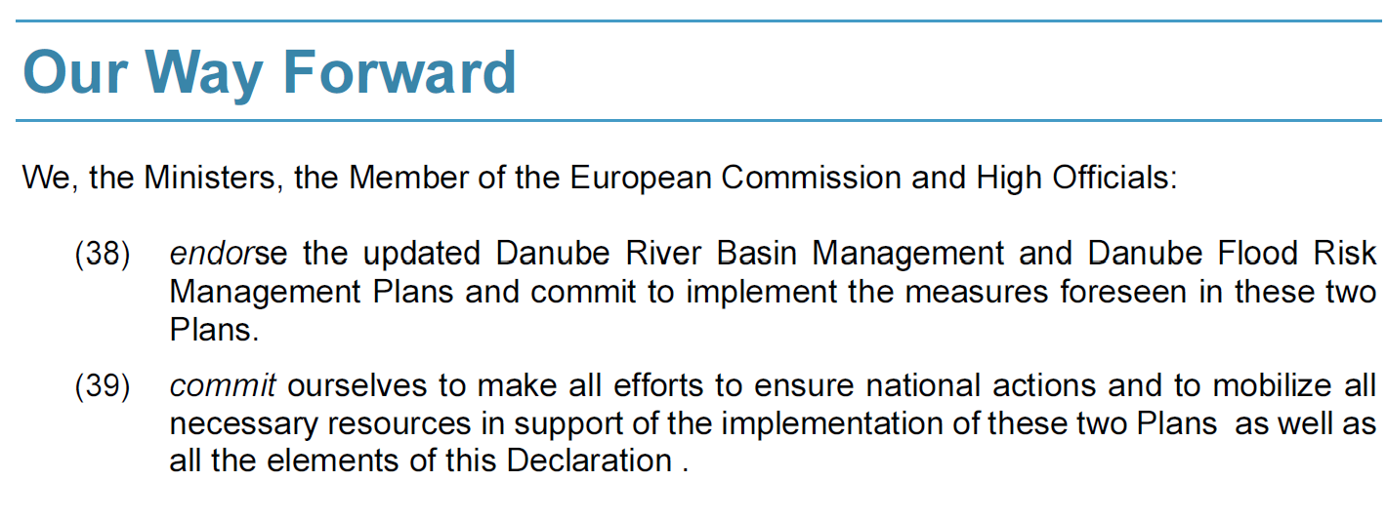
Danube Ministerial Declaration 2022

Slide 16
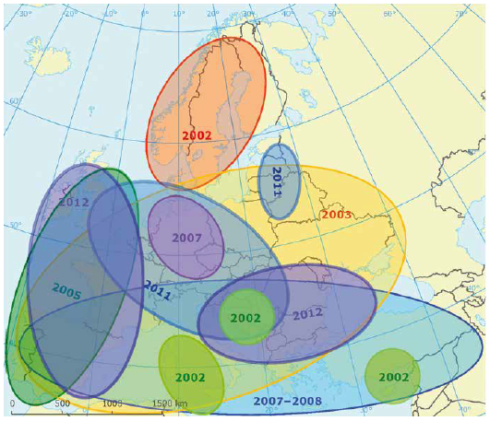
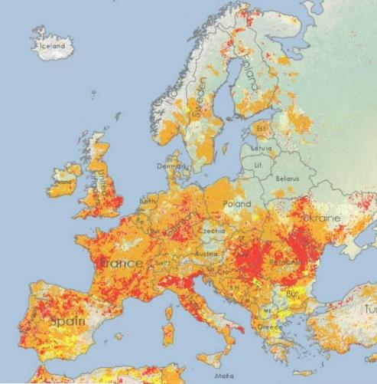
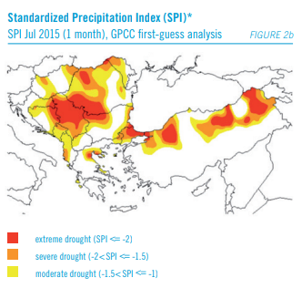
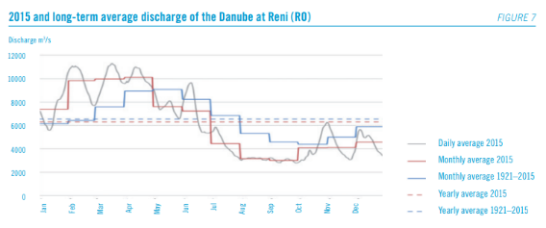
Recent Droughts in the Danube Basin
2015 2017
Combined Drought Indicator for August 2022
2015 Drought and Danube Discharge
EDO (JRC)

Slide 17
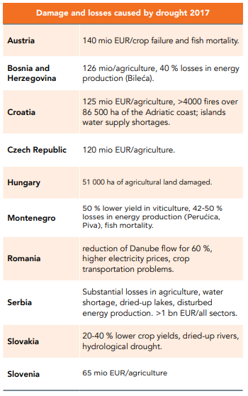
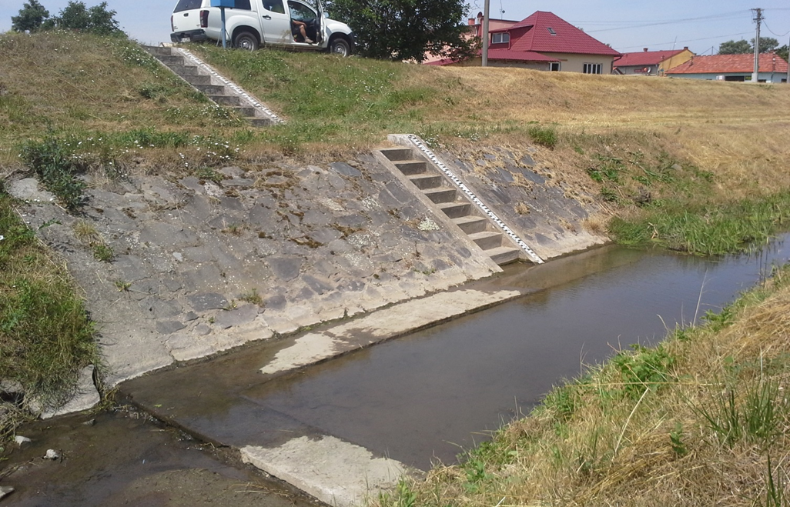
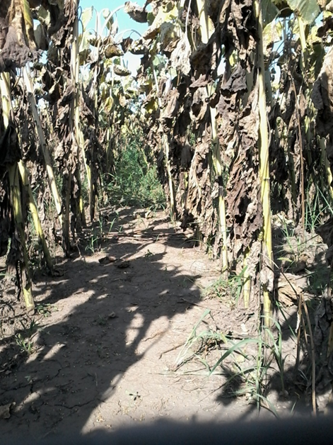
Drought Impacts
Drought consequences:
Impacts on aquatic and terrestrial ecosystems
Impacts on water uses, e.g.
Lack of precipitation - reduced summer crop yield
Low water levels - impacts on navigation
Reduced stored water volume - impacts on hydropower
Potential water scarcity and resource overexploitation
DriDanube
DriDanube
DriDanube

Slide 18
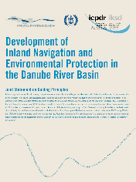
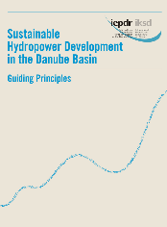
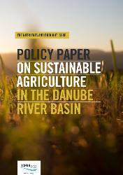
Current/Possible Future ICPDR Activities on Droughts
Internal ICPDR Workshop on drought in the DRB:
Understand and identify DRB transboundary needs
Determine the role of ICPDR to put forward basin-wide actions
Sate-of-the-art DRB Drought Overview Report being developed:
Inventory of policies, plans, approaches, tools, databases and measures
Recommended basin-wide activities based on a stepwise approach
Tackle the way towards Water Resilience
Potential follow-up activities for the near future:
Developing a water balance model for the DRB
Developing a consistent drought impact database (EU JRC)
Promoting smart agriculture and water use efficiency (FAO)
Organizing an international drought expert workshop (World Bank)
Fostering intersectoral dialogues with water users

Slide 19
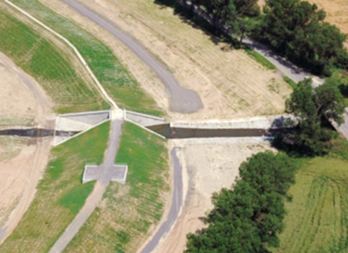
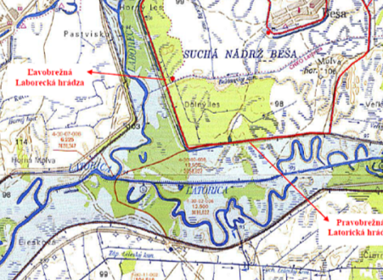
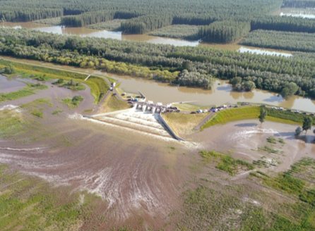
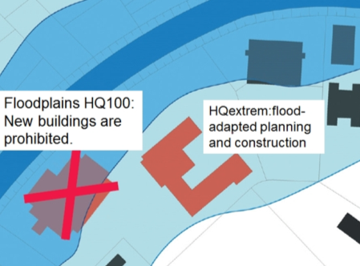
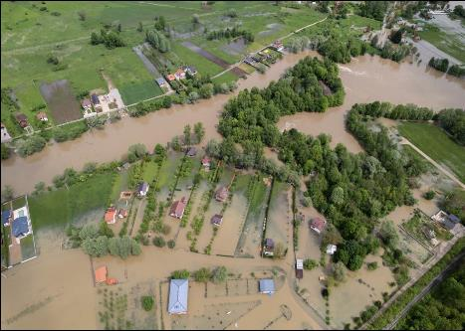
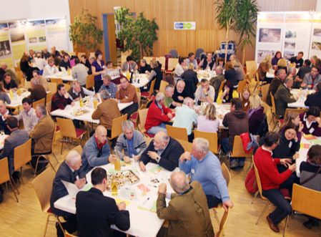
Thank you
SK
CZ
HU
DE
RO
BMLFUW, AT
www.icpdr.org

