Slide 1








3RD NATIONAL PARTICIPATION DAY - AUSTRIA
Panel 2: Biodiversity Crisis & Challenges for Water Quality
09.04.2024 | 09.00 -18.00 CET
BOKU River Lab (BOKU Wasserbaulabor)
Am Brigittenauer Sporn 3, 1200 Vienna

Slide 2



Biodiversity Crisis & Challenges for Water Quality
Panel 2
Assist. Prof. Dr. Bano Mehdi-Schulz
Priv.-Doz. Dr. Gertrud Haidvogl
Univ. Prof. Dr. Thomas Hein
BOKU University

Slide 3
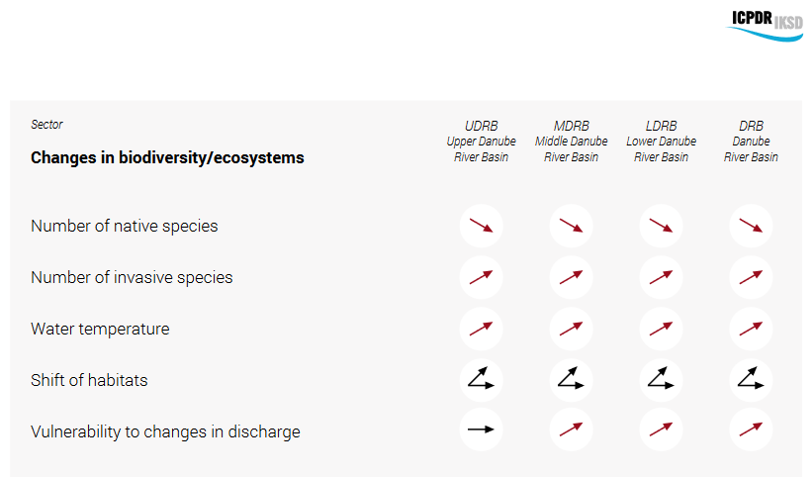
Biodiversity in the Danube River Basin
Home to unique ecosystems, with approx. 2000 plant and 5000 animal species
Climate change will increase air and water temperatures. More variable precipitation and water flows will impact ecosystems, habitats and biodiversity. Consequences are:
Migration patterns expected to expand northward and to higher altitudes
Some species will be threatened for extinction
Invasive species may increase
Shifts in flora and fauna
High stress for aquatic ecosystems, littoral communities and aquatic species
Notes:
Wetlands, floodplains, ecological stability and ecosystem services

Slide 4
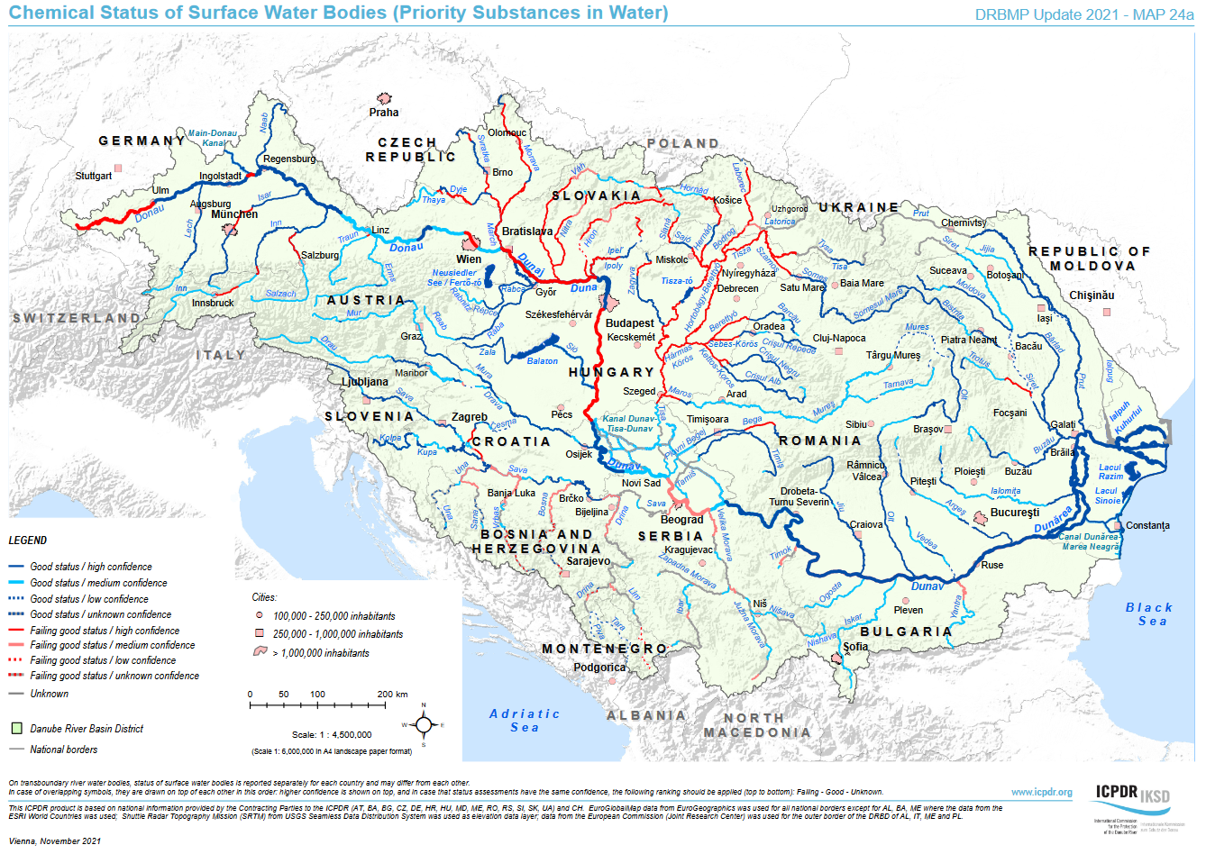
Water Quality in the Danube River Basin
Improvements over last years, but still much work to be done, must consider both the ecological and chemical status
Climate change will exacerbate current threats, including agricultural runoff, industrial discharge, sediment transport, waste water treatment.
Groundwater declines esp. in summer, coupled with higher water withdrawals. Nutrient concentrations increase
Higher water temperatures, decreasing O₂ concentrations in rivers, aquifers and lakes
Emerging / hazardous substances, plastic pollution, etc. will affect drinking water
Aquatic life and biodiversity negatively affected
Notes:
GW declines in in Central and Eastern Europe in summer
Decline in snow and ice as water storage

Slide 5
Adaptation needs to progress into the future
Integrated water resources management. Considers interconnections between land, water and ecosystems and is implemented with river basin management plans for all countries in the Danube basin
Enhancing the capacity of ecosystems to adapt. Measures such as flood defenses, restoring wetlands, retaining water in landscape.
Building resilience in the water resources sector. Capacity building, transboundary cooperation and knowledge and data sharing.
Broad interdisciplinary approach. Fostering dialogue between scientists and diverse societal stakeholders
Addressing emerging environmental challenges. Training a new generation of river experts, applying modelling tools and cutting-edge research

Slide 6
Abschlussworte
Now its the PhD students turn...
Vorname Nachname
Abteilung / Institut / Department / Stabstelle etc.
T +43 1 47654-XXXXX
email@boku.ac.at
BOKU University
Straße Hausnummer
PLZ Ort
Department of Water, Atmosphere and Environment
BOKU University
boku.ac.at

Slide 7










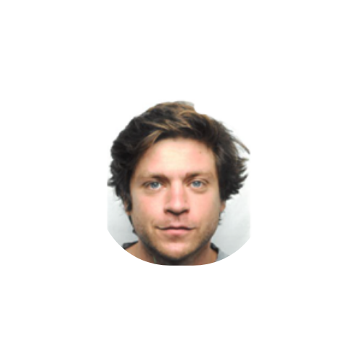
Biodiversity Crisis & Challenges for Water Quality
PA 4
Water Quality
PA 6
Biodiversity and landscapes, quality of air and soils
Protecting the Environment
Aurora Gitto
Nolitha Gcakasi
Flavia Byekwaso
Hatice Turk
Johannes Kowal
Jakob Neuburg
Marton Toth
MourineYegon
Anthony Basooma
Waterborne bacteria identification for water quality monitoring
Isoptopes for monitoring groundwater nitrate
Water quality of a tropical wetland working as a Nature Based Solution
Water quality and
nutrients travel time
Connectivity and biodiversity
Biodiversity & the bottom fish fauna
Landscape effects on soil quality and biodiversity
Aquatic-terrestrial linkages
Species distribution modeling and connectivity

Slide 8

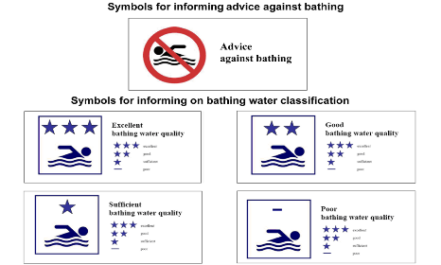

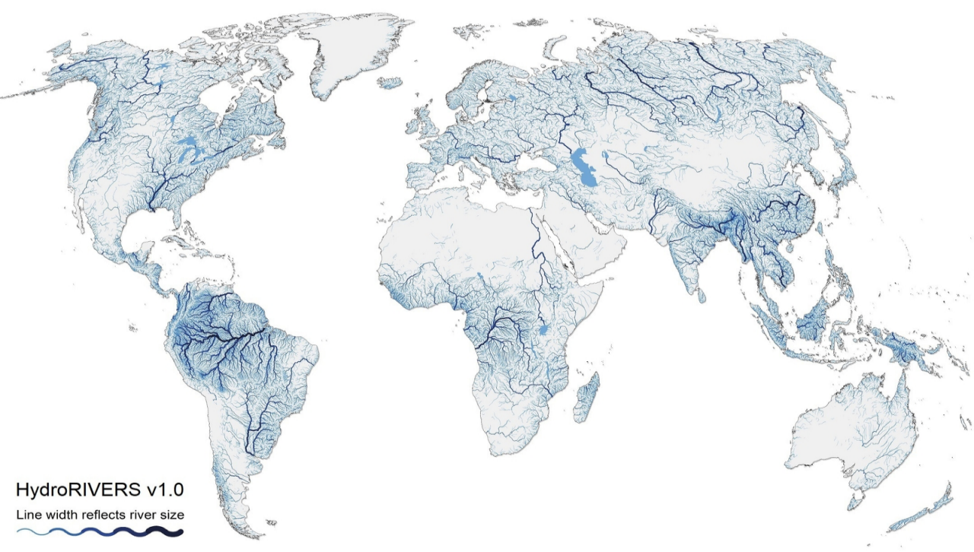
PA 4 – Water Quality
Water quality for safety reason (EU regulations – drinking water, bathing water)
Parameters and critical/threshold values
Today Challenges
Rivers, streams and groundwater bodies face numerous threats
Pollution
Over-extraction
Deforestation
Climate change.

Slide 9
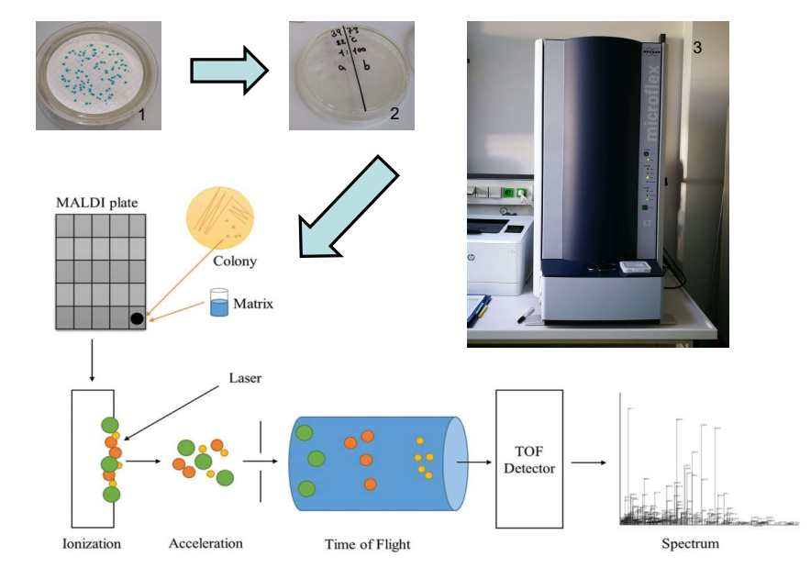
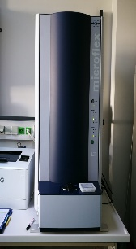
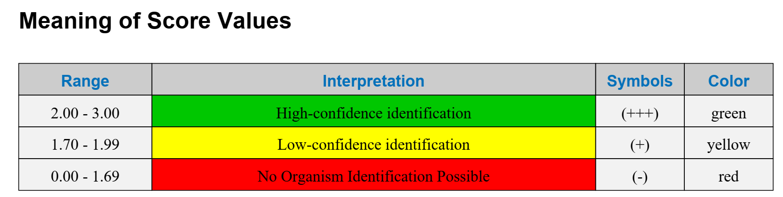
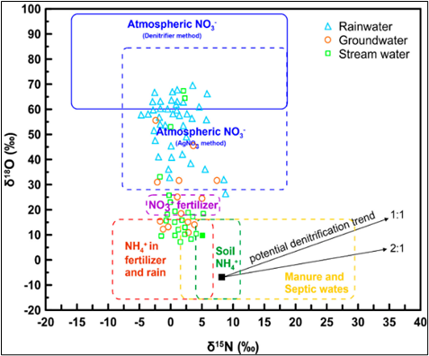
Waterborne bacteria identification for water quality monitoring
Water quality riverbank filtration and ground water, increasing the bacteria community information​
New technology for the identification but missing environmental information of waterborne bacteria
Aurora Gitto
Isotopes for monitoring groundwater nitrate
PA 4
Water Quality
Measuring nitrate isotopes in groundwater samples using the titanium reduction method
Identification of nitrate sources, transport and biogeochemical cycling
Quantification of denitrification potential and rates
Nolitha Monis
Gcakasi

Slide 10
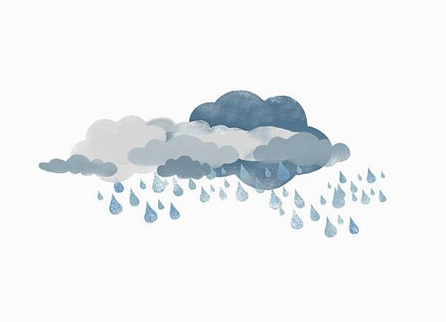

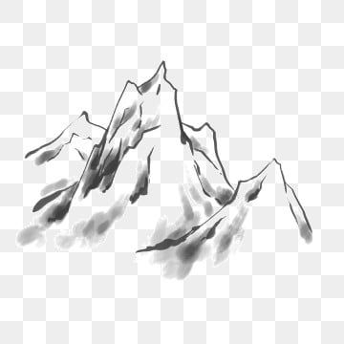
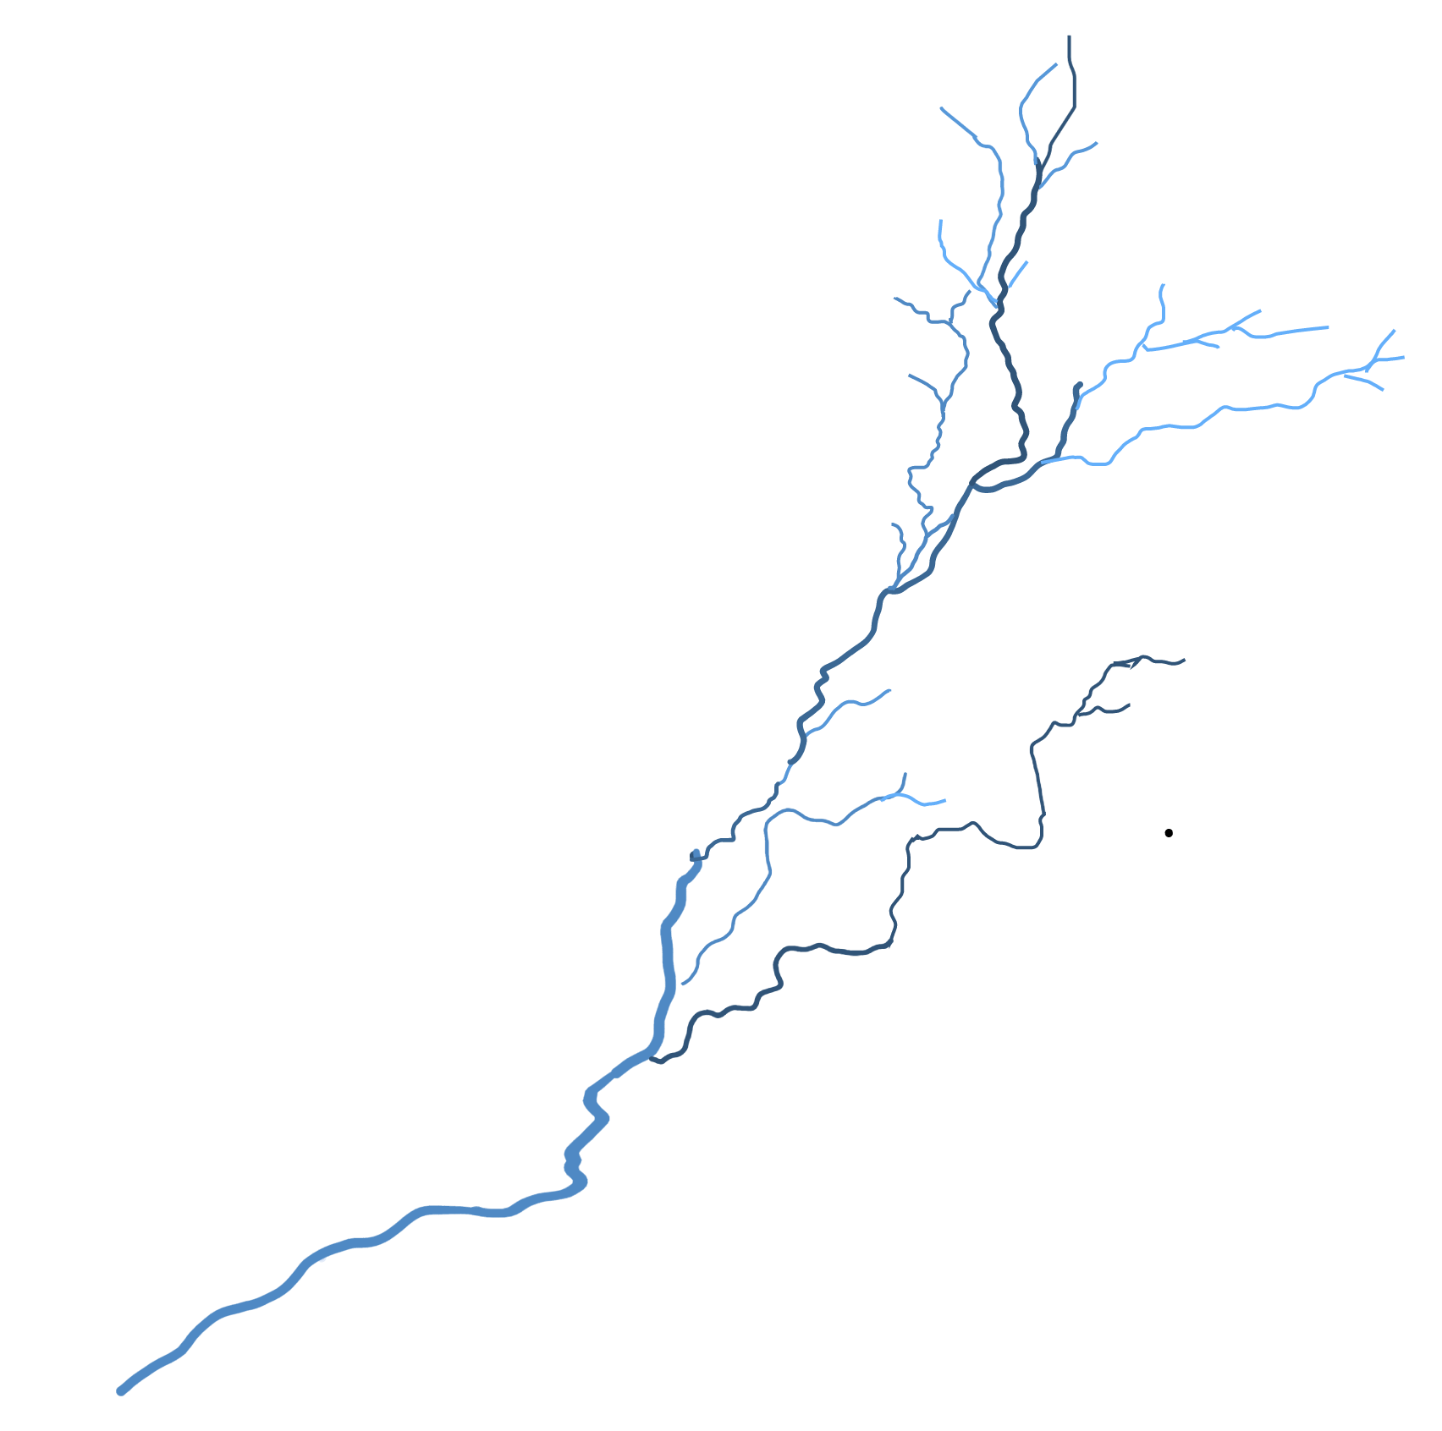
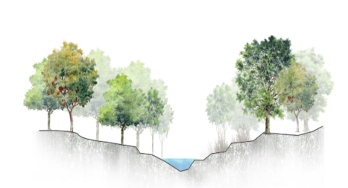
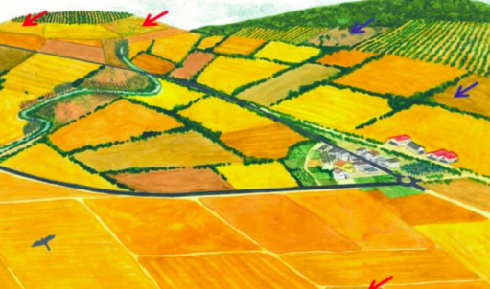
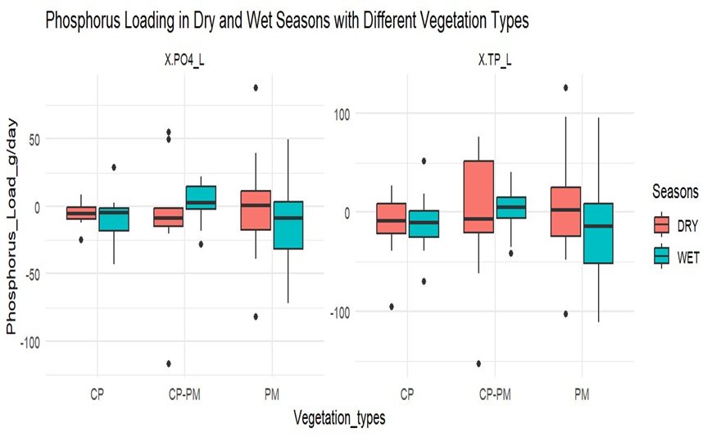

Hydrological controls on catchment scale water travel times and nutrient transport
Using water stable isotopes and conceptual model to estimate water travel times
To assess how the intensity and frequency of seasonal rainfall, topography and vegetation influence the water travel times
Potential and limits of a natural wetland and its most influential plant type in pollution mitigation during the wet and dry seasons
  Time in (Age = 0)
δ¹⁸O
δ¹⁸O
Hatice Turk
Time out (Age = T)
δ¹⁸O
PA 4
Water Quality
Water quality of a tropical wetland working as a nature based solution
Flavia Byekwaso

Slide 11
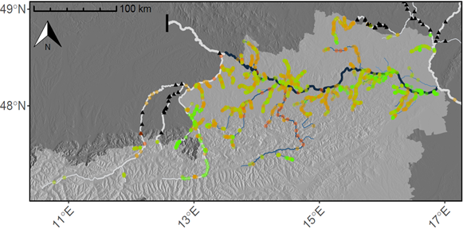
PA 6 - Biodiversity and landscapes, quality of air and soils
Enhance ecological connectivity
Develop conservation action plans and/or management plans for endangered umbrella species of the Danube Region
Enhance and/or maintain soil-related ecosystem services
Today Challenges
Rivers, streams and groundwater bodies face even more threats
Blocking of migration routes
Connectivity loss
Habitat alteration
Land-use change
Notes:
MARTON:

Slide 12
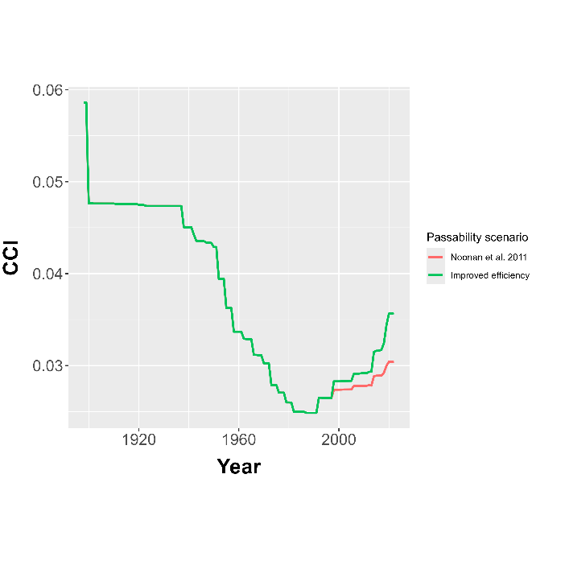
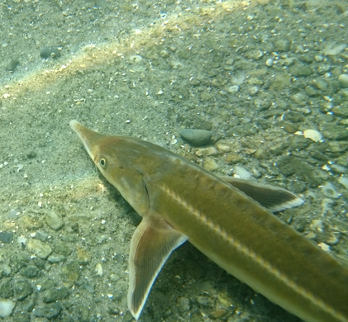

Connectivity and biodiversity
Quantitative assessment of spatiotemporal connectivity changes in fluvial systems
Estimation of connectivity status quo and efficient planning of restoration/conservation measures
α
Diversity
Johannes Kowal
β
Connectivity
Species distribution modeling and effects of connectivity
PA 6
Biodiversity and landscapes, quality of air and soils
Resource allocation
Quantitative assessment of fish communities and umbrella species in the Danube and tropical systems
Establish monitoring based decision tools to prioritize the management of natural resources
Management Plan
Species Distribution Model
Jakob Neuburg
Anthony Basooma
Monitoring data

Slide 13
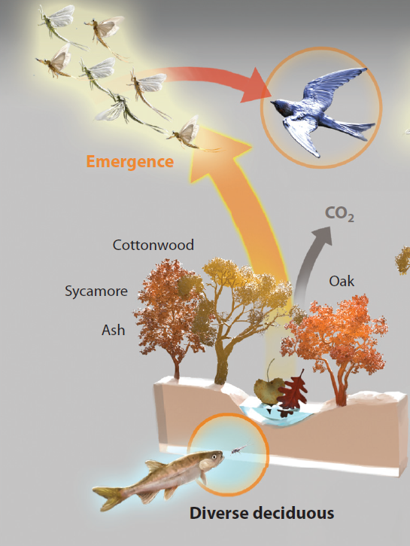
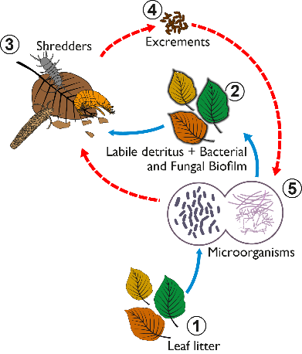
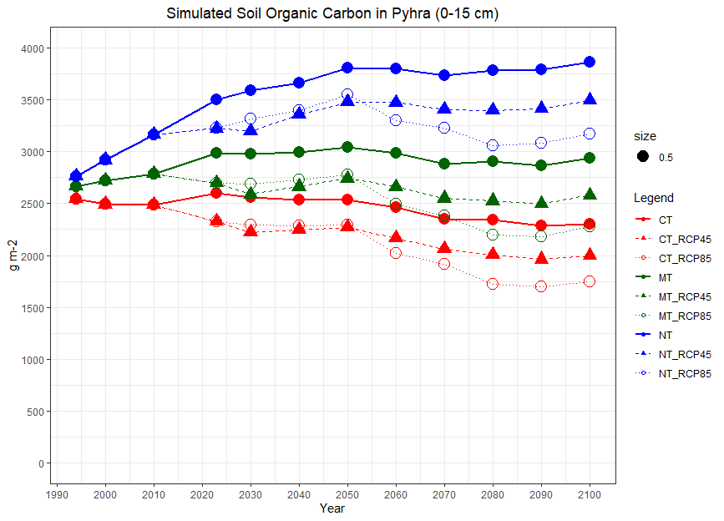
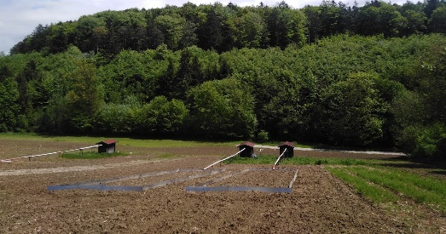
Aquatic-terrestrial linkages
Assessing the effects of leaf litter quality and aquatic insect diversity on stream ecosystem functions (i.e. coarse particulate decomposition and fine particulate matter composition)
Linking biodiversity in aquatic-terrestrial interfaces to stream ecosystem functioning
Mourine Yegon
Landscape effects on soil quality and biodiversity
PA 6
Biodiversity and landscapes, quality of air and soils
Investigation of effects of landscapes and tillage systems on soil health and nutrient cycling
Linking the long-term effects of tillage practices and soil erosion on the nutrient storage capacity of soils to historical land-use changes
Marton Toth

Slide 14
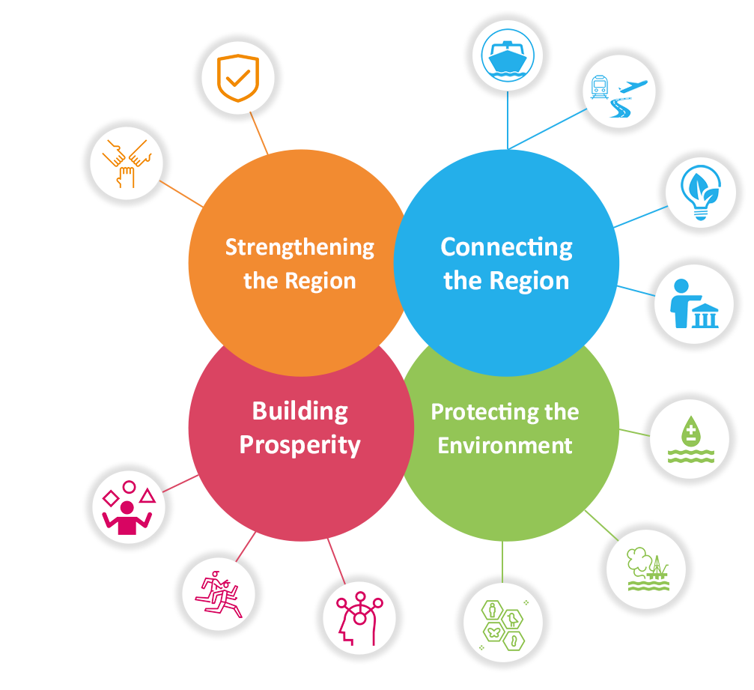







Our research helps establishing a scientific base to:
Counteract habitat and biodiversity loss
  Re-establish habitat connectivity and migration routes
Reduce soil erosion through sustainable agriculture
Improve monitoring systems
  Increase efficiency of water quality monitoring
Implement integrative and sustainable management plans
Notes:
Aurora Challenges: achieving a faster and easier results for future water quality analysis

