Slide 1
Future challenges in water quality
Dr. Carmen Postolache

Slide 2
Outline
The Danube River
The Danube River Basin
Danube water quality trends
Results of transnational assessments
Hydro-morphological alterations and climate changes
Challenges
Solutions
The way ahead

Slide 3
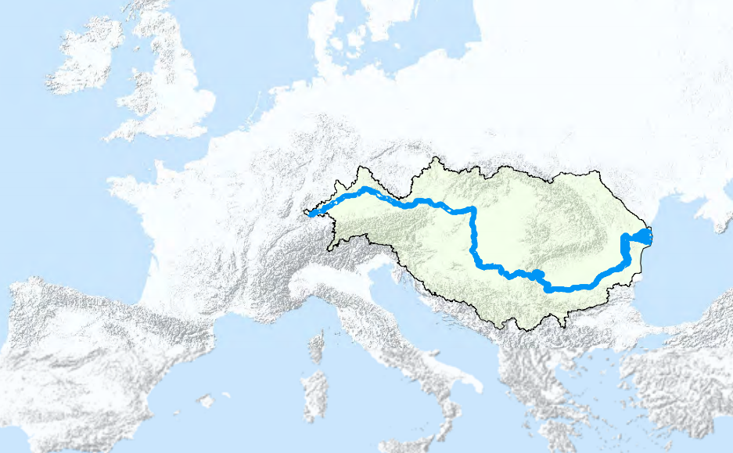
The Danube River
Second largest river in Europe - 2,857 km
Spring: Black Forest (DE)
Outflow: Black Sea – Danube Delta
(RO, UA)
Average discharge: 6500 m³
Crosses 10 countries:
DE, AT, SK, HU, HR, RS, BG, RO, MD, UA
Catchment extends over 19 countries
Source: www.icpdr.org

Slide 4
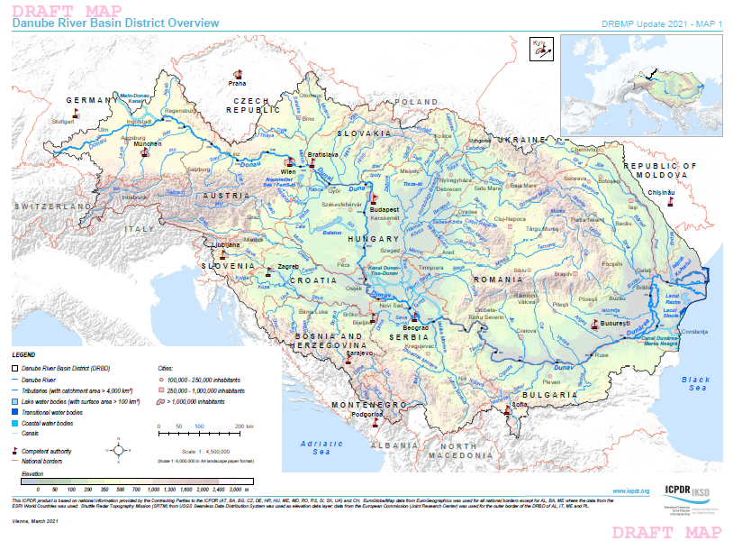
The Danube River Basin
Catchment > 800,000 sq.km (10% of continental Europe)
Population: approx. 80 mil. inhab.
27 large tributaries
> 300 small tributaries
Average precipitation range
(Brilly, 2010):
-3200 mm/year in the W, high mountain regions of the Alps
-350 mm/year in the E, lowland regions – Black Sea Brilly, 2010).

Slide 5
Danube water quality trends
Water quality was a key issue for Danube and coastal zone over the last 70 years
Water quality between 1950s-1970s in the Upper Danube
Improvement in early 1980s in the upper part – construction of WWTP
Deterioration of water quality in the middle-lower part
Some sections in the Middle and Lower part of Danube are considered possible at risk or at risk
Deterioration of water quality in the Danube Delta complex of ecosystems

Slide 6
Nutrient Overload in Danube Basin
In Danube Basin, nitrogen and phosphorus discharges into the Black Sea were increased continuously since the early 1960s, and specifically during the 1980s.
Peak loads of nitrogen and phosphorous occurred in 1980s and early 1990s
The Western Black Sea has suffered chronic harmful algal blooms, permanent hypoxic situations, as well as mass mortalities of benthic and pelagic organisms including fish.
In the mid- and late 1990s some positive changes were documented as a result of a slight anthropogenic pressure reduction.
Nitrate contamination is recognized as a main water quality issue in the Danube Basin.
In addition to lake eutrophication, nutrient discharges deteriorate the water quality of receiving rivers.

Slide 7
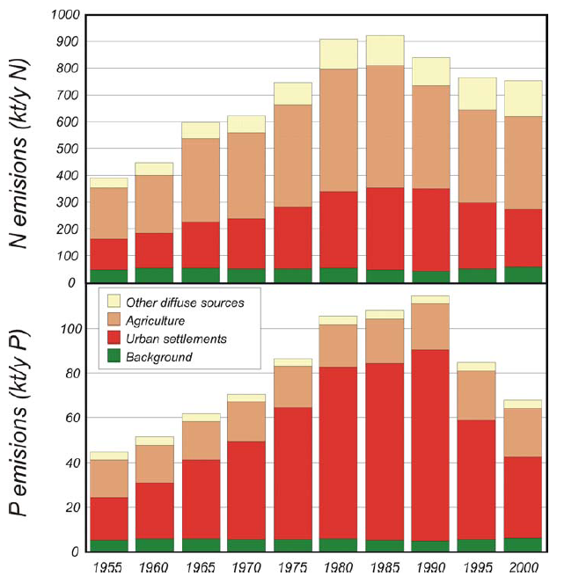
Danube water quality trends
Changes of N, P emissions into the river system of the Danube between 1955 -2000
(daNUbs report 2005)

Slide 8
Nutrient overloads in the Lower Danube River System and Danube Delta
Period/ Parameter | LDRS |  | Danube Delta
 | 1980 | 1990 | 1981-1982 | 1986-1987 | 1991-1993
DIN (μg N. l⁻¹) | < 1200 | > 2200 | 90-800 | 250-800 | 90-1000
TRP (μg P. l⁻¹) | 5-30 | 70-280 | 3-34 | 10-108 | 3-116
N : P | >> 10 | < 7 | 14-116 | 7-59 | 3-45

Slide 9
Nutrient Overload in Danube Basin
Causes of deterioration: industrial development, poor pollution control, polluted tributaries
Mismanagement of nutrients in the Danube Basin has led to severe ecological problems:
    groundwater deterioration;
    the eutrophication of rivers, lakes and especially the Black Sea.
The problems are directly related to social and economic issues (e.g. drinking water supply, tourism and fishery as suffering sectors; agriculture, nutrition, industry and waste water management as responsible sectors).

Slide 10
Nutrient Overload in Danube Basin
Nitrogen emissions from all sources within the subcatchments of the Danube in the period 1998-2000
(daNUbs report 2005)

Slide 11
Significant Water Management Issues
Pollution by organic substances (emissions of non-toxic organic substances that can be biologically decomposed by bacteria to a high extent)
Pollution by nutrients (releases of nitrogen – N and phosphorus – P into the aquatic environment)
Pollution by hazardous substances (contamination with priority substances and other specific pollutants with toxic effects on aquatic organisms and humans)

Slide 12
Significant Water Management Issues
Total Phosphorous content significantly decreased: introduction of P-free detergents, P-retention in WWTP, economic breakdown in downstream countries, retention in Iron Gates reservoirs
Phosphorous loads decreased to the levels of 1950s
Nitrogen inputs slightly decreased since the peak in 1980s
Nitrogen loads are 2.2 times higher than in 1950s
Differences between nutrient loads and fluxes are ~ 300000 tN/year and ~ 50000 tP/year
High retention and transformation capacity of the basin

Slide 13
Governance
The Danube River Protection Convention (DRPC) (Sofia, 1994), provides the legal framework for cooperation on water issues within the Danube Basin
The 14 countries with territories > 2,000 km² included the DRB cooperate in the frame of the International Commission for the Protection of the Danube River: Austria (AT), Bosnia and Herzegovina (BA), Bulgaria (BG), Croatia (HR), Czech Republic (CZ), Germany (DE), Hungary (HU), Moldova (MD), Montenegro (ME), Romania (RO), Serbia (RS), Slovakia (SK), Slovenia (SI) and Ukraine (UA).
The DRPC Contracting Parties have established the International Commission for the Protection of the Danube River (ICPDR) to facilitate transnational cooperation and implement the DRPC
After the adoption of the EU Water Framework Directive (WFD, 2000), ICPDR coordinates also the implementation of WFD in the Danube River Basin
ICPDR countries, including non-EU Member States (MS), agreed to implement the WFD throughout the entire basin

Slide 14
EU Water Framework Directive
A key policy instrument in water management
Objective (by 2027):
to achieve for all inland surface waters, transitional and coastal waters
  Good chemical status
  Good ecological status (or potential)
to achieve for all groundwaters
  Good chemical status
  Good quantitative status

Slide 15
EU Water Framework Directive – Meeting the objectives
ICPDR: “Danube River Basin Management Plan” (DRBM Plan) – 2009
  assessments and measures towards the achievement of ”good status” by 2015
Not all waters would hit the target in six years, the WFD requires to update the DRBM Plan in 2015 and 2021
DRBM Plan – Update 2021 includes
  updated assessments on the main pressures impacting the Danube basin’s waters
  updated information on water status and progress achieved
  the joint further actions agreed by the Danube countries to be undertaken until 2027 on the basin-wide level (Level A) as well as the national level (Level B)

Slide 16
Water Status – the results of the Monitoring Programs
Monitoring results according to the WFD:
serve the validation of the pressure analysis
an overview of the impacts on water status is required in order to initiate measures
The ICPDR Transnational Monitoring Network (TNMN)
Initially launched in 1996 to support the implementation of DRPC
Major objective: to provide an overview of the overall status and long-term changes of surface water and, where necessary, groundwater status in a basin-wide context (with particular attention paid to the transboundary pollution load)
http://www.icpdr.org/main/publications/tnmn-yearbooks

Slide 17
The Transnational Monitoring Network (TNMN)
114 monitoring sites at the basin wide level
  located just upstream/downstream of an international border
  located upstream of confluences between Danube and main tributaries or main tributaries and larger sub-tributaries (to enable estimation of mass balances)
  located downstream of the major point sources
  located to control important water uses
Frequency:
  Daily (flow)
  annually / 12 x per year
  annually / 26 x per year (annual loads)
  Sites required to estimate pollutant loads (e.g. of nutrients or priority pollutants) which are transferred across boundaries of Contracting Parties, and which are transferred into the marine environment

Slide 18
The Transnational Monitoring Network (TNMN)

Slide 19
Results from DRBMP – Updated 2021 - Ecological status/potential
GES/GEP or above – 24.1%

Slide 20
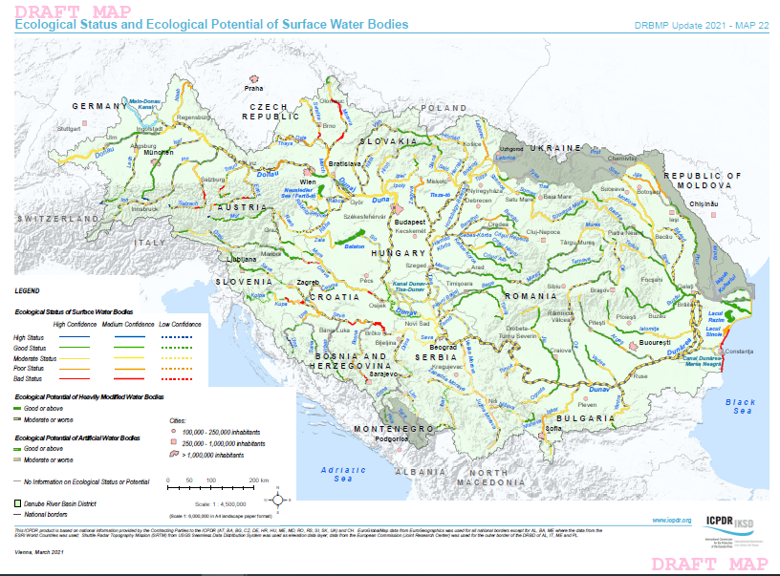
Results from DRBMP – Updated 2021
Ecological status/potential
GES/GEP rivers – 24.1%
Ecological status
High status – blue
Good status – green
Moderate – yellow
Poor status – orange
Bad status – red

Slide 21
Results from DRBMP – Updated 2021 – Chemical status
GCS – 36.0 % (in water and biota)
GCS – 67.7 % (in water only)

Slide 22
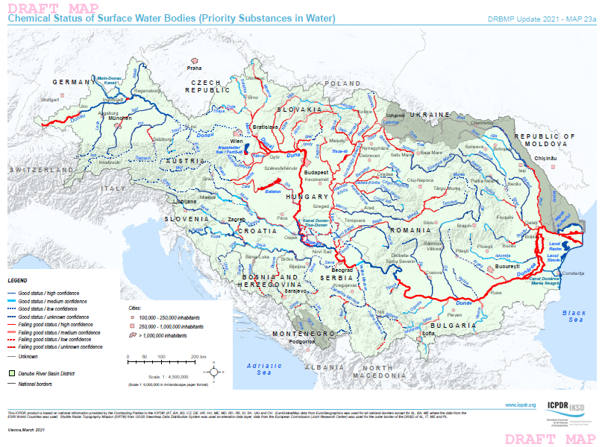
Results
Chemical status
45 Priority substances, e.g
Benzene
Brominated diphenylethers (PBDE)
Cadmium, lead, mercury, nickel and compounds
Chloroalkanes
Dioxins
Hexachlorocyclohexane
Polyaromatic hydrocarbons
…
Full list of priority substances provided in Dir. 2013/39/EU

Slide 23
The DRBM Plan – Significant Water Management Issues
Hydro-morphological alterations – anthropogenic pressures resulting from:
    various hydro-engineering measures on flood protection
    hydropower generation
    inland navigation
Effects of climate change – changes in discharge patterns:
    drought
    water scarcity
    extreme hydrological phenomena

Slide 24
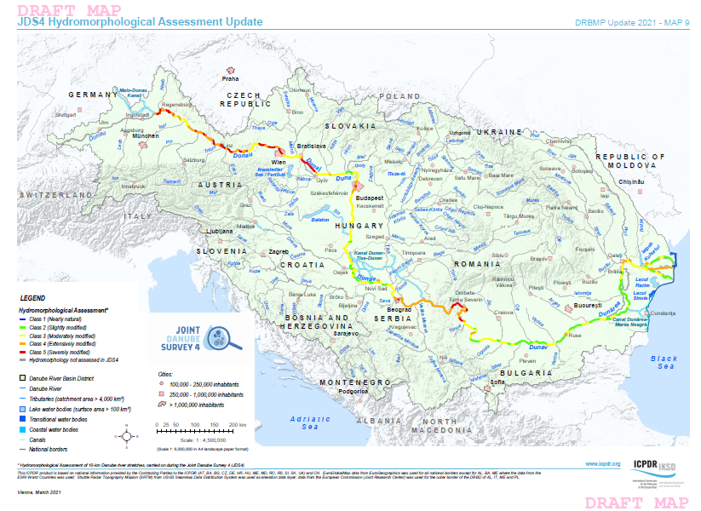
Results
Hydromorphological assessment (Joint Danube Survey, 2019)
Impact of hydromorphological
alterations:
Affect connectivity
Change hydrology (flow, discharge)
Habitat fragmentation
Loss of floodplains/ wetlands
Change sediment flux (e.g Iron Gates sediment retention)

Slide 25
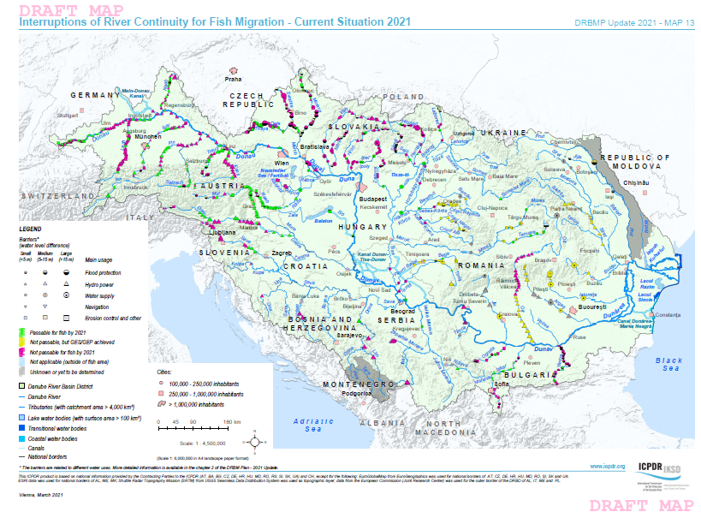
Results
Hydromorphological assessment (Joint Danube Survey, 2019)
A key challenge - habitat loss/fragmentation
River continuity interruptions
Total: 942
Danube: 82
Strong biodiversity gradient, increasing from W to E
High number of endangered species
Freshwater migratory fish – 93% decline in Europe (WWF, 2020)

Slide 26
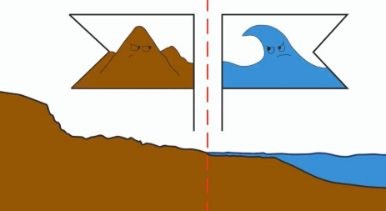
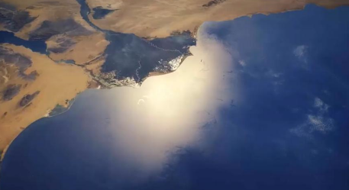
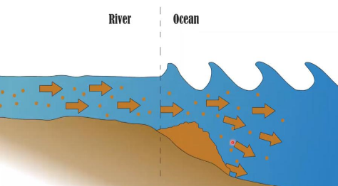
Effects of climate change – formation and erosion of deltas
Factors controlling Deltaic morphology
    The amount of fresh water
    Type and quantity of material transported
    Physical properties and dynamic movements of water in the drainage basin
    Climatic conditions
    Fluctuations of sea level
    The suspended sediment load of Danube River decreased from ~ 40 million t/year to ~ 7.3 million t/year

Slide 27
Effects of climate change
Effects of climate change:
  changes in climatic conditions and effects on the hydrological cycle and water temperature are observed
  drought
  water scarcity
  extreme hydrological phenomena
Modeling of climate change scenarios predicted:
  increase in air temperature – highest in the southeastern Danube region
  sea level raise
Data | ∆ T (⁰C) | Sea level (cm)
2000 | 0 | 0
2010 | 0.2 | 2
2050 | 0.8-2.6 | 5-32
2100 | 1.4-5.8 | 9-88

Slide 28
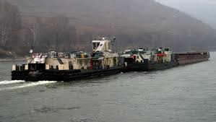
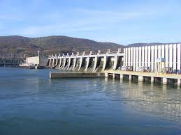
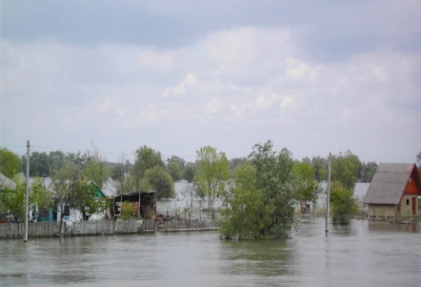
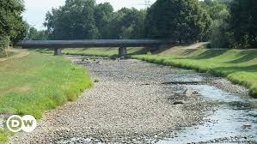
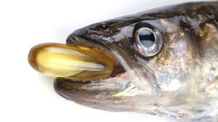
Challenges
Navigation development – river channelization, embankments, pollution
Hydropower plants - dams, flow alteration, hydropeaking, disruption of river continuum, altered sediment transport
Agriculture – pollution with nutrients, pesticides, water abstraction
Climate change – increased frequency of extreme weather events, modification of precipitation and discharge patterns, water temperatures raise
Overexploitation – excessive fishery, gravel extraction from the river bed, increased water abstraction
Emerging pollutants – pharmaceuticals, endocrine disruptors, microplastic

Slide 29
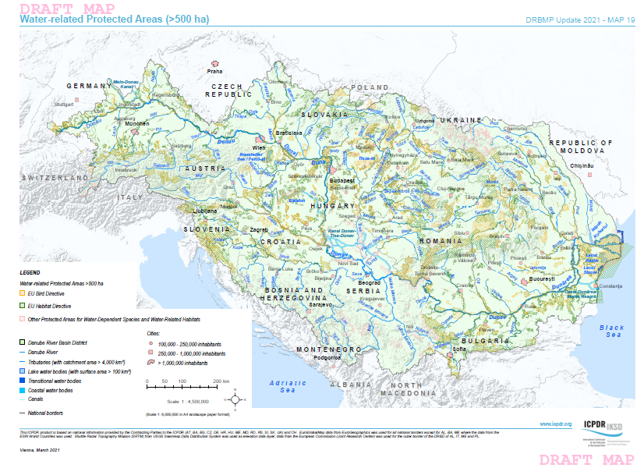
Solutions
Water related protected areas
Areas designated for the abstraction of water intended for human consumption
Areas designated for the protection of aquatic species with economic imp.
Waterbodies designated as recreational waters, including bathing waters
Nitrates vulnerable zones
Areas designated for the protection of habitats or species where water status is important for their protection
Integrating water-nature policies

Slide 30
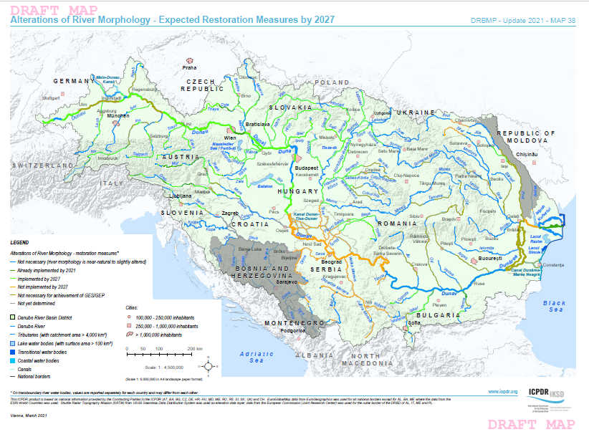
Solutions
Restoration of
aquatic habitats
Restoration of endangered species (Danube salmon, sturgeons, otter, etc)

Slide 31
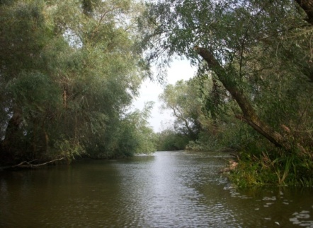
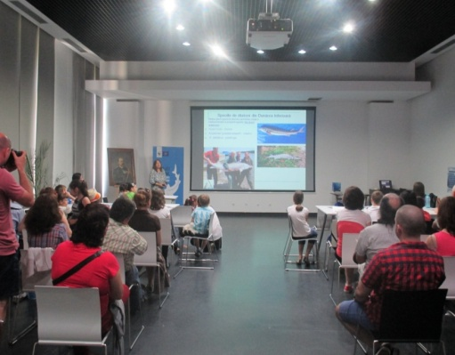
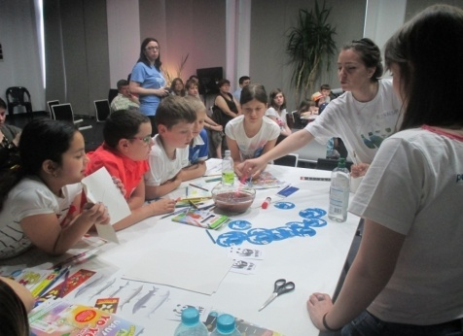
The way ahead
Foster implementation of environmental legislation
Integrative water management
Research and innovation
Active dialogue with project developers and key stakeholders
Public consultation
Enhanced environmental education of young generations
Training/involvement of public in nature conservation - Citizen science

Slide 32
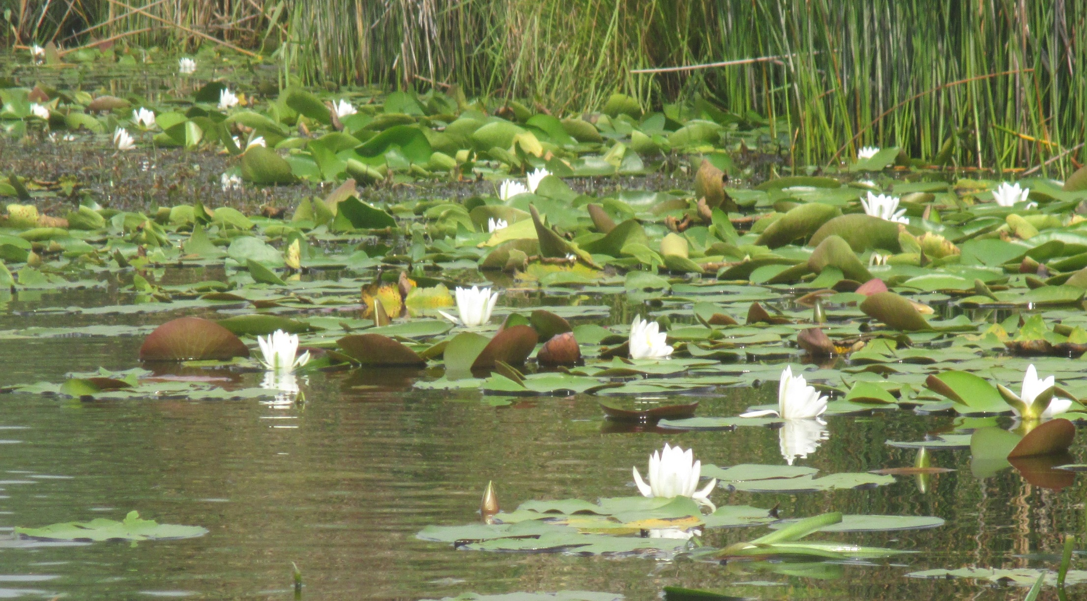
Thank you for your attention!

