Slide 1
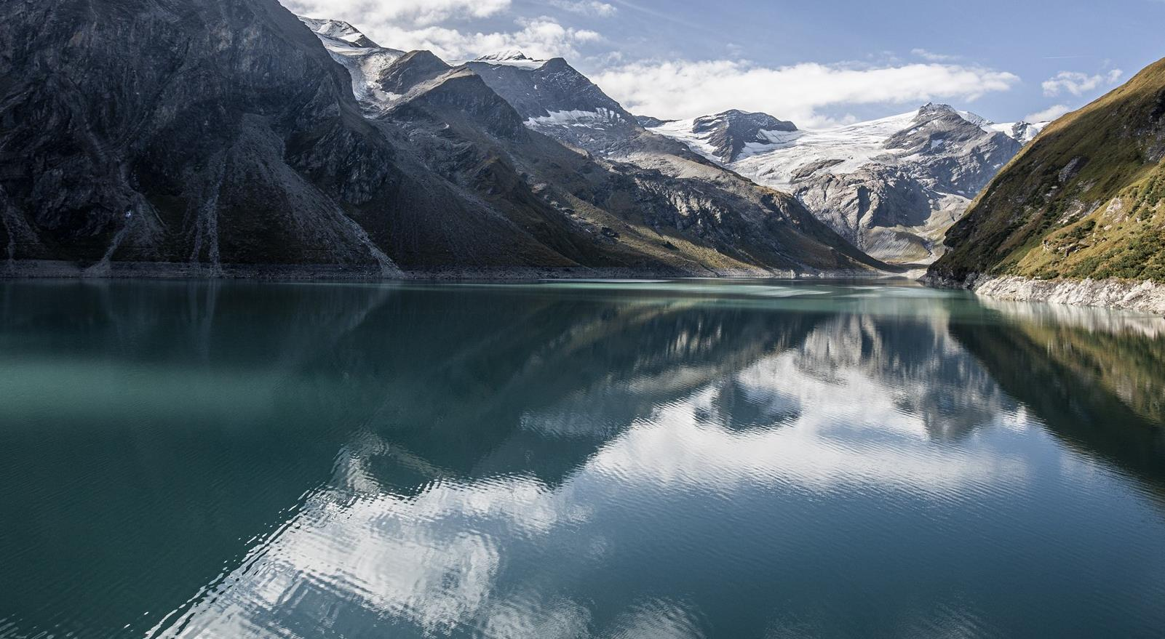
Hydropower
EUSDR - National Participation Day
Panel 3: Energy & Transport
Herfried Harreiter
Vienna
April 2024

Slide 2


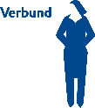






VERBUND at a glance
>500,000
private customers
around 3,200
employees
up to ¼ of
total
generation
from wind/PV by 2030
51%
~97%
generation from
renewable
sources
First credit in the world
assessed purely
on sustainability
Austria’s
leading
energy
company
owned by the Republic
of Austria
No. 1
with industrial customers
Energy-related
products &
services
Social
Responsibility:
>€3.3m in contributions
to VERBUND electricity aid
fund of Caritas
since 2009
First
Green Bond
corporate
bond in German-
speaking region
129
hydropower plants
over 8,300 MW
Austria-wide
charging
infrastructure
for electric vehicles
flexible gas power plants
Supply
security
Environmental measures:
€280m
investment by 2027
Market leader
in flexibility and
green electricity sales
in Austria
and Germany
Listed
company
with outstanding
compliance
culture
Cross-regional
APG electric grid
around 3,400 km
of power lines
One of the largest
hydropower
generators in
Bavaria
more than 2,000
apprentices
trained
in past
70 years
900 km
high-pressure natural gas
pipeline of
GasConnect Austria
Core markets
AT & DE
Strategic focus
Southern & Southeastern
Europe

Slide 3
Hydropower in Europe – actual Status
    2021 the generation from Hydropower within the European Union (EU) was nearly 350 TWh/a pure generation plants (run-of-river and reservoir storage) and almost 30 TWh from pumped storage ⁽¹⁾
    These two forms of hydropower generation provide about 34% of the electricity generated from renewable energy sources and about 13% of the gross electricity generation of EU27 in 2021 ⁽¹⁾
    The technically feasible potential was estimated for EU27 with app. 650 TWh/a ⁽²⁾. In practice social, economic, environmental and regulatory factors must be taken into consideration
    Additionally, there is an additional potential for pumped storage in the Alpine regions
    Source: vgbe (Hydropower in Europe Facts and Figures)
    Source: Hydropower & Dams World Atlas, 2022
Hydropower Generation in Europe 2021 (vgbe)

Slide 4
Hydro Power in Danube River Basin
(Source: ICDPR)

Slide 5
Multipurpose Use of Hydropower
Source: Eurelectric

Slide 6
Climate Neutrality: projected Development of Renewables
    European Perspective, Decarbonizations Speedways Project (Eurelectric, 2023)
    By 2040, electricity generation will nearly need to double
    To ensure security of supply in a system with high shares of renewables, firm and dispatchable technologies will be massively needed.
    Austrian Perspective 2020 to 2040 (Oesterreichs Energie, 2023)
    Doubling of renewable Generation, Tripling of renewable Capacity
    Need for additional Flexibility / Storage
Development of RES Capacities 2020 to 2040 (Eurelectric, 2023)

Slide 7
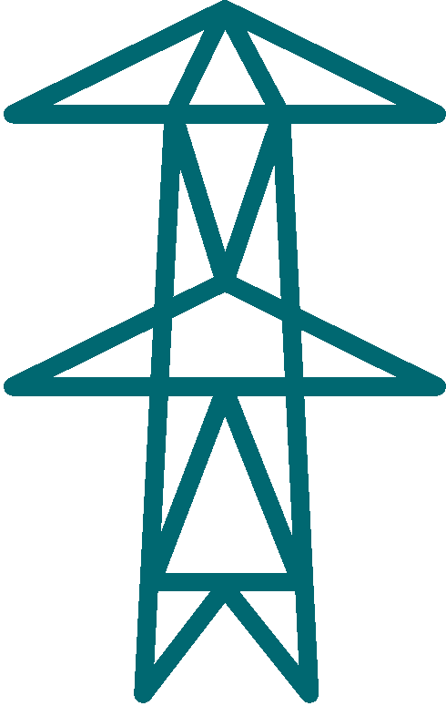




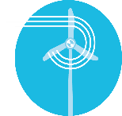
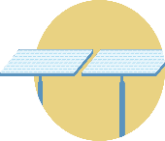

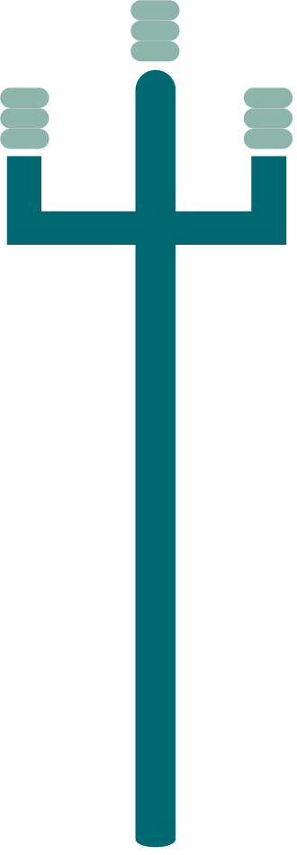
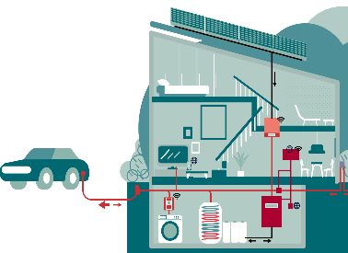


Climate Neutrality: Need for Systemic Approach
Flexibility and storage
(Capacity MW)
Renewable generation
(Energy kWh)
Transmission and distribution
Storage-/Pumped Storage Power Plants
Run Off River Plants
100% renewable electricity system
Security of Supply
Affordability

Slide 8
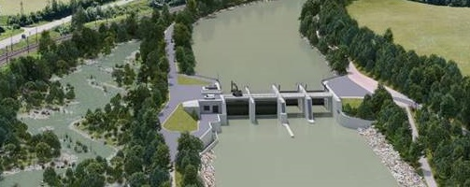
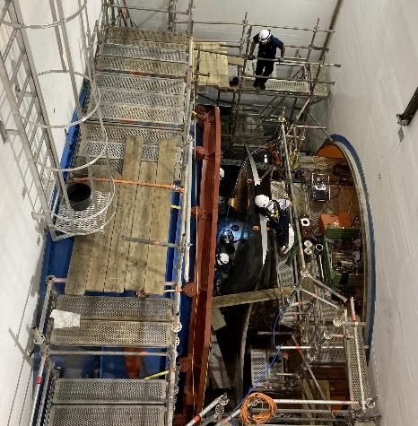
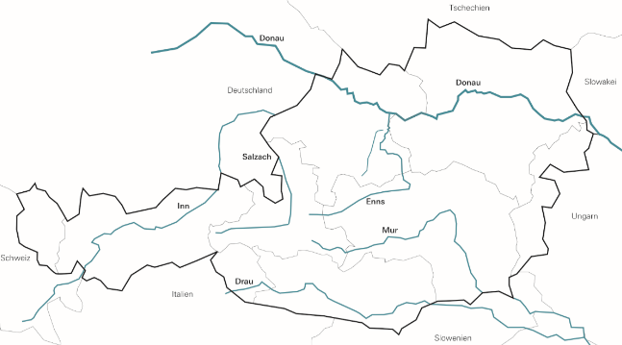
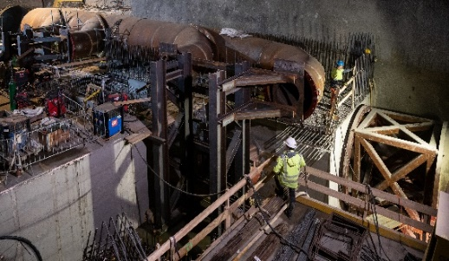
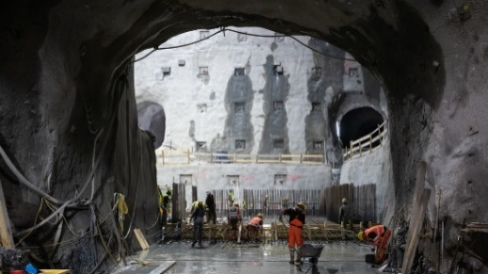
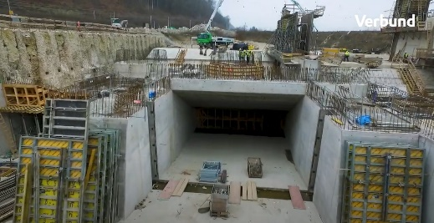
Current Hydropower Projects of VERBUND
4 Refurbishments Inn
+156 GWh, +37,5 MW
Ering-Frauenstein, Egglfing-Obernberg,
Braunau-Simbach, Rosenheim
3 Refurbishments Danube
+123 GWh, +37 MW
Jochenstein, Ottensheim-Wilhering,
Wallsee-Mitterkirchen
Stegenwald
72,8 GWh, 14,3 MW
Greenfield (50 % VERBUND)
17 Projects
12 Refurbishments, 3 extension projects, 2 Greenfield
650 MW turbine capacity
600 MW pump capacity
470 GWh generation
1,5 billion Euro investment
1 Refurbishment Mur
+21,8 GWh, +6,3 MW
Laufnitzdorf
RII+
45 MW; extension
Gratkorn
54 GWh, 11 MW
Greenfield (50 % VERBUND)
4 Refurbishments PSP
+32 GWh, +20 MW-T, +72 MW-P
Limberg II, Roßhag, Pumpwerk Reißeck,
Malta Hauptstufe (Pelton - Turbinen)
KKW Spiegelwald
9,5 GWh, 3,2 MW
extension
Limberg III
480 MW; extension
Note: Projects completed in 2022: Töging, Ybbs-Persenbeug, Arnstein,
Kaprun Oberstufe, Malta Hauptstufe (Pumpen), Gerlos 1 and KKW Häusling

Slide 9
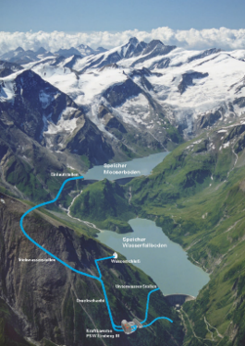
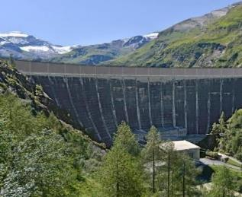
Case Example: Limberg III Pumped Storage Power Plant
Extension of the Kaprun power plant group
Additional hydraulic connection of the two existing annual reservoirs Mooserboden (84.9 million m³) and Wasserfallboden (81.2 million m³)
Cavern power plant with 480 MW flexibility capacity
Dam heightening to increase storage volume
Comprehensive ecological measures: Designation of Natura 2000 area "Alpine alluvial land Drossen", recultivation of heaps from the 1950s
Investment of approximately 570 million Euros
Technical Data Limberg III
reversible pump turbine (variable speed) | 2 x 240 MW (2 x 100 bis 240 MW)
Total max. discharge | 2 x 72 m³/s
Hydraulic head | 365 m
Length of power water ways | 5,4 km
Rise of dam crest of Limberg dam | + 11 m
Additional reservoir capacity | 12,7 Mio. m³
Construction period | 2021 - 2025

Slide 10
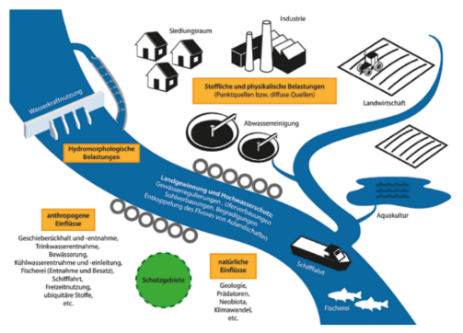
Ecology, Water Framework Directive and Biodiversity
    Hydropower
      Responsible only for app. 10 bis 15% of barriers in rivers
      Due to implementation of Water Framework Directive (WFD) more than 20 years' experience in implementation of mitigation measurements
      Implementation in Austria based on R&D projects (e.g.: SuREmMa, ÖkoReSch, CD Labor für Sedimentforschung und –management, CD MERI – Dynamik von META-Ökosystemen,… )
    Specific Hydro Power Issues:
      Connectivity
      Ecological Flow
      Hydropeaking
      Sediment Management
      River Morphology
    Impacts on river ecosystems caused by multiple water users (beside Hydropower), e.g. Agriculture, Water Supply, Sewerage Systems, River Navigation, Industry, Tourism,….
Water Use and responsibilities in a „Multistressor-System“ (Source: Reckendorfer et al, 2017, Wasserwirtschaft 107, Page 82-86)

Slide 11


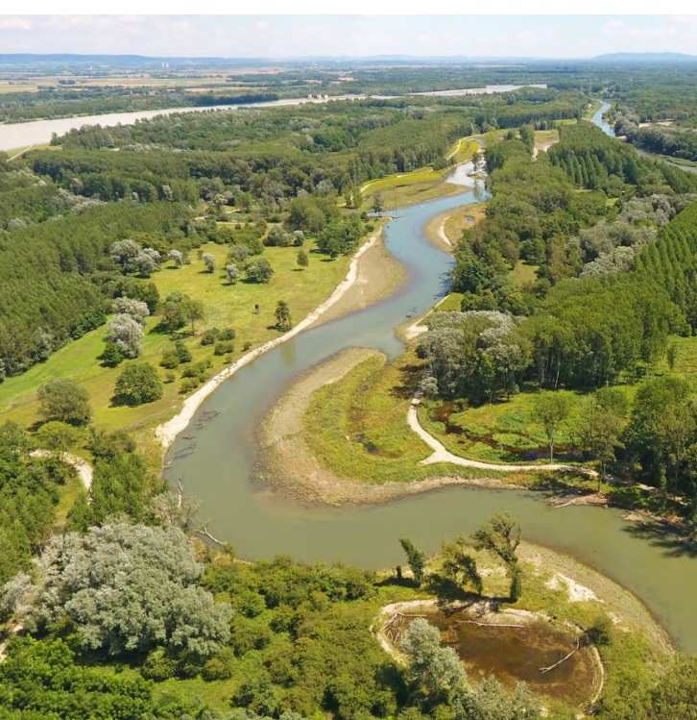
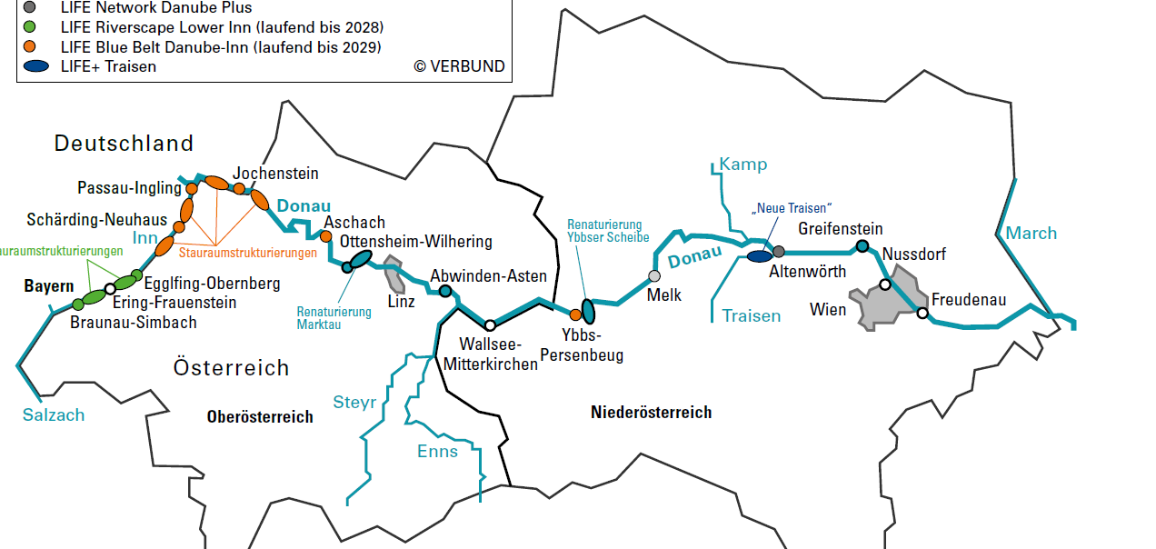

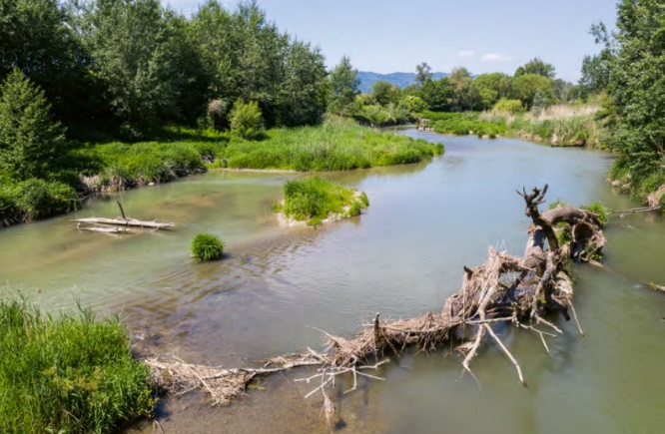
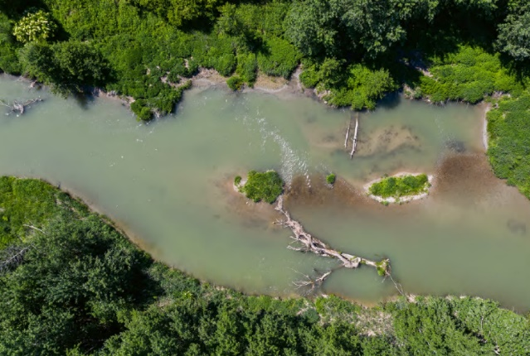
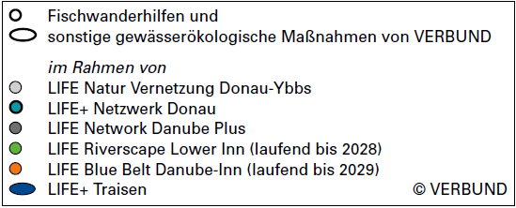
Success Story Life Projects
LIFE+ Network Danube: Fish pass at the Ottensheim-Wilhering power plant
LIFE+ Network Danube: Naturally designed section in the Aschach
LIFE+ Traisen: Overview of the middle section of the "Neue Traisen"
Seite 11

Slide 12
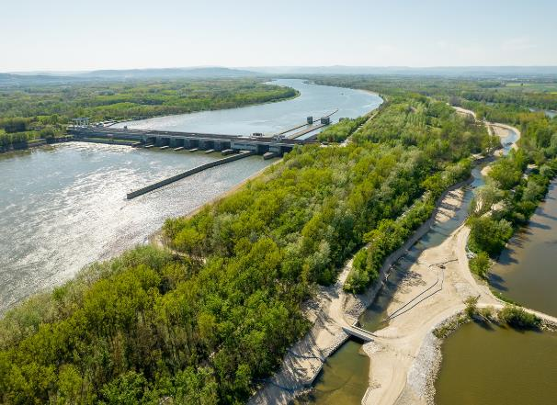
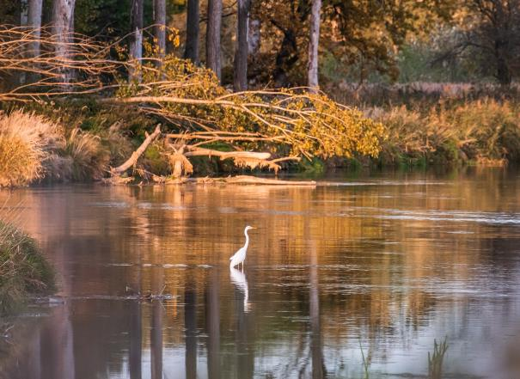
Summary
    Actual generation from Hydropower within the European Union (EU) provide about 34% of the electricity generated from renewable energy sources and about 13% of the gross electricity generation
    Although the decarbonization of the European energy system will be mainly driven by development of Wind an PV capacities, hydropower will play a vital role also in the future:
      Generating renewable and reliable energy by existing and new developed capacities
      Providing dispatchable and firm capacities and supporting integration of Wind / PV into the system
      Although the potential for greenfield projects in Europe is limited, there are additional potential for refurbishment and extension of existing schemes
    What is needed for the further development of Hydropower in Danube Catchment:
      Clear commitment to the performance of European hydropower (including pumped storage) as a renewable form of energy with multifunctional tasks and an important contribution to security of supply
      Level playing field with other forms of renewable energy in all administrative and economic environment conditions (outstanding public interest, efficient approval procedures, subsidies…)
      Balanced implementation of environmental targets and requirements (Water Framework Directive, Biodiversity Strategy…)

Slide 13
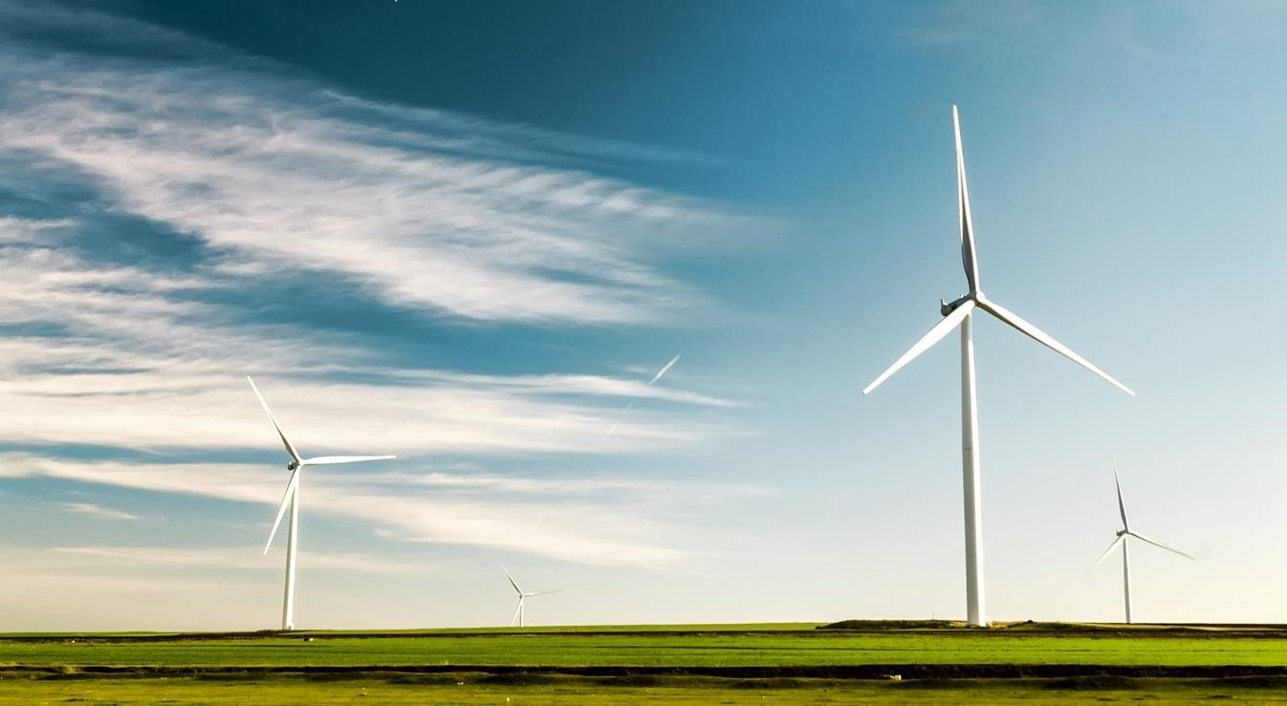
The power of transition

