Slide 1
Marcin SADOWSKI DG MARE, European Commission

Slide 2
Mission “Restore our ocean and waters”:
Main features
Stemming from Horizon Europe → a new way of organising research and innovation around big themes and impact-driven actions
Mission work programmes → calls for proposals
Going beyond HE – a federating initiative aiming at demonstrating the technical, economic and/or societal viability of innovative solutions in a (near to) operational environment and supporting their upscale and replication
Societal buy-in
Bringing in funds from outside HE (e.g.: regional funds, EMFAF,…)
Synergies with other programmes and partnerships
Community-building!

Slide 3
Mission objectives and targets
Protect and restore marine and freshwaters ecosystems and biodiversity
Protect at least 30% and strictly protect 10% EU’s sea areas
Prevent and eliminate pollution of our oceans, Seas and waters
Make the blue economy carbon- neutral and circular
Net zero maritime emissions
Zero carbon aquaculture,
Reduce by at least 50% plastic litter
Restore 25.000 km free flowing rivers
Marine nature restoration targets (incl. degraded seabeds, coastal ecosystems)
Reduce by at least 30% microplastics
Reduce by at least 50% nutrient losses, chemical pesticides
Low carbon multipurpose use of marine space
ENABLERS: - Digital Ocean and waters knowledge System
- Public mobilization and engagement

Slide 4
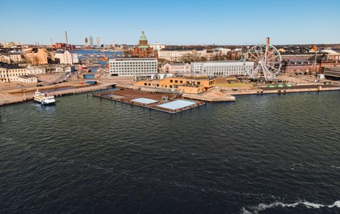
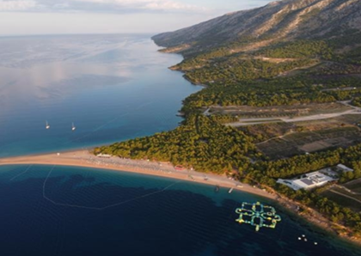
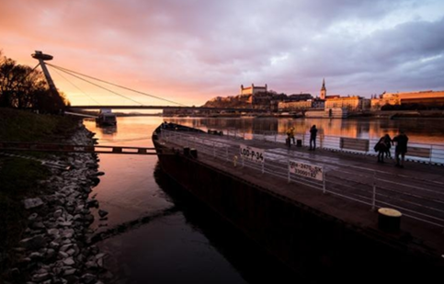
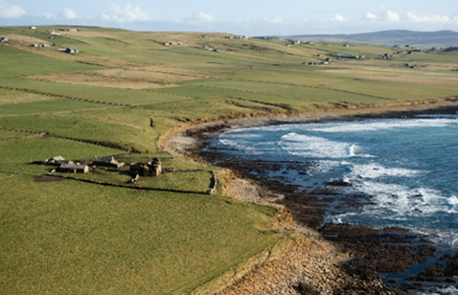
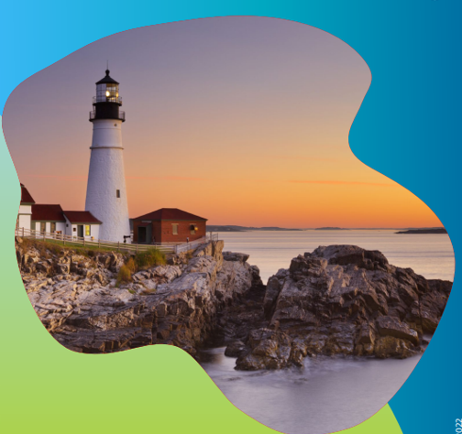
Mission four lighthouses: sites to pilot, demonstrate, develop and deploy the Mission activities across EU seas and river basins
Mediterranean sea basin
Baltic & North Sea basin
Danube river basin
Atlantic & Arctic sea basin

Slide 5
Mission work programmes 2021-2022-2023-2024:
EUR 118 million EU funding 20 projects ongoing
EUR 130 million EU funding 26 Grant Agreements in preparation
WP in preparation: expected publication 17 April, 2024, deadline September 2024
EUR 117 million EU funding 20 projects ongoing
2021
2022
2023
2024

Slide 6
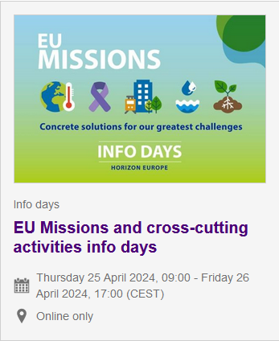
Mission work programme 2024:
https://research-innovation-community.ec.europa.eu/events/3WjiVunxm0t5j4zQlVax3Q/overview

Slide 7
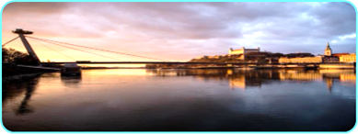
Danube lighthouse
Portfolio of projects
Lighthouse CSA - 3M€
EcoDaLLi - ECOsystem-based governance with DAnube lighthouse Living Lab for sustainable Innovation processes
Restoration of fresh & transitional waters ecosystems
IA - 17M€
2021
DANUBE4all - Restoration of the Danube river basin waters for ecosystems and people from mountains to coast
DALIA - Danube Region Water Lighthouse Action
Protection & restoration of wetlands, flood plains, coastal wetlands & salt marshes and their biodiversity
IA - 17M€
DaWetRest - Danube Wetlands and flood plains Restoration through systemic, community engaged and sustainable innovative actions
Restore4Life - Restoration of wetland complexes as life supporting systems in the Danube Basin
2022
2023
Demonstration of effective and sustainable management of sediments
IA - 17M€
2 proposals in Grant Agreement Preparation

Slide 8
Mission Charter: Our joint commitment to restore our ocean and waters
Join forces for a transformational change for a healthy ocean and waters
A simple, inclusive, efficient and inspirational framework to enhance cooperation to deliver on Mission objectives
Open to any (public or private) interested parties
Actions can cover R&I, Knowledge & Data, Citizen engagement, Upscaling/deployment of solutions, Education & Training

Slide 9
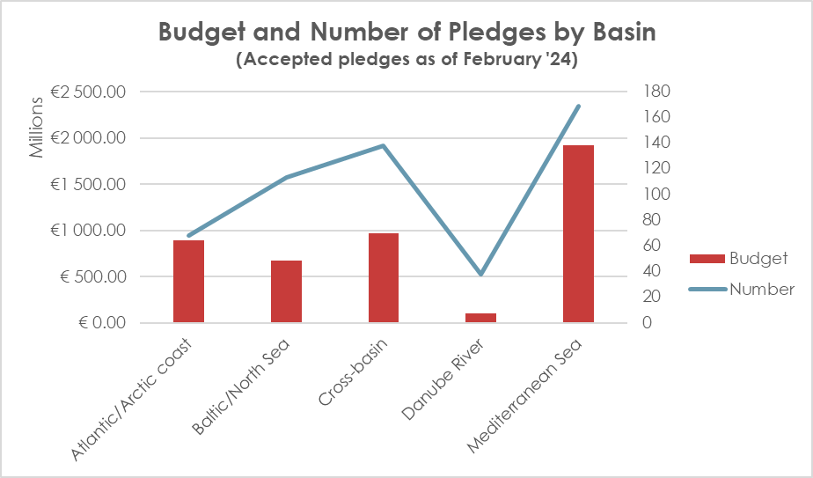
Mission Charter actions
More than 650 actions pledged with 526 actions visible to the Mission Atlas
Budget: €4,56 billion

Slide 10
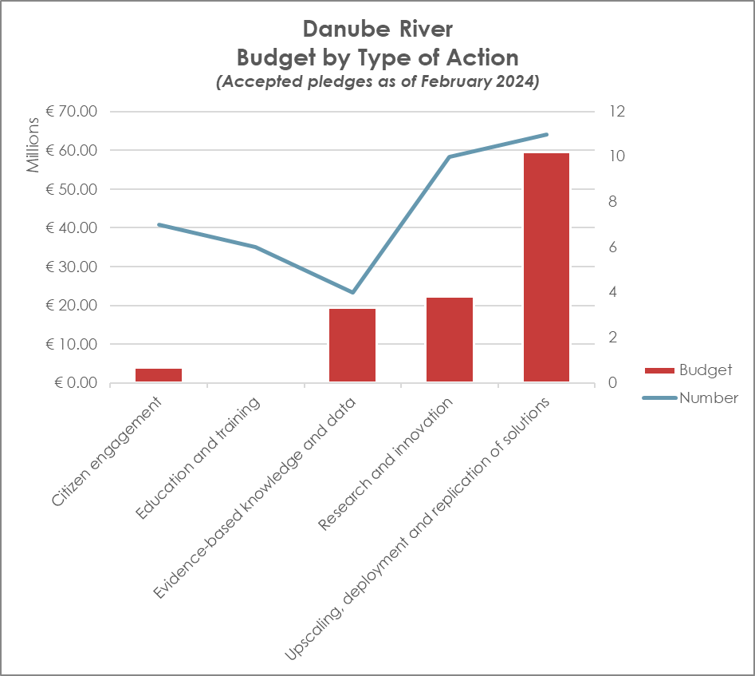
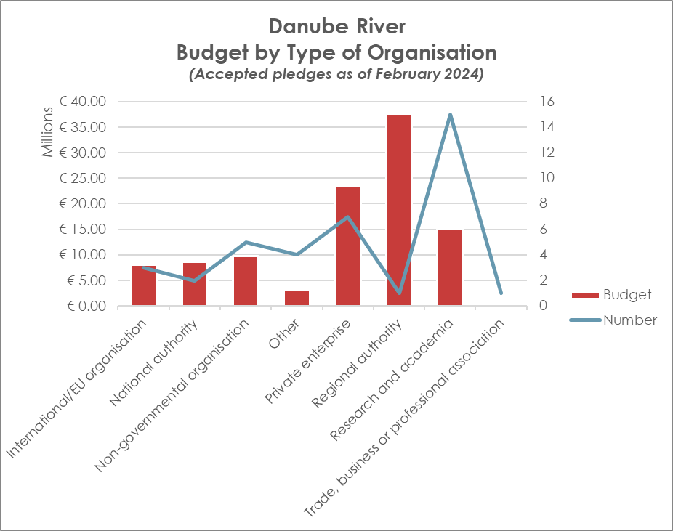
Mission Charter actions – analysis by basin [Danube River]

Slide 11
The concept of Associated regions in the Mission work programme:
How do associated regions work ?
Calls for Associated regions organised by relevant projects, with an evaluation based on transparent and fair procedures (Publication in the Funding and Tenders Portal)
Financial support to third parties:
may only be awarded to local and/or regional authorities from an associated region.
the maximum amount to be granted to each associated region is EUR 100,000
Projects should continuously share their outcomes and knowledge with the ‘associated regions’ and provide them with technical assistance to build capacity and to implement solutions in their territory that contribute to achieving the Mission objectives.

Slide 12
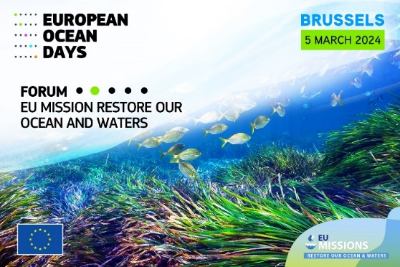
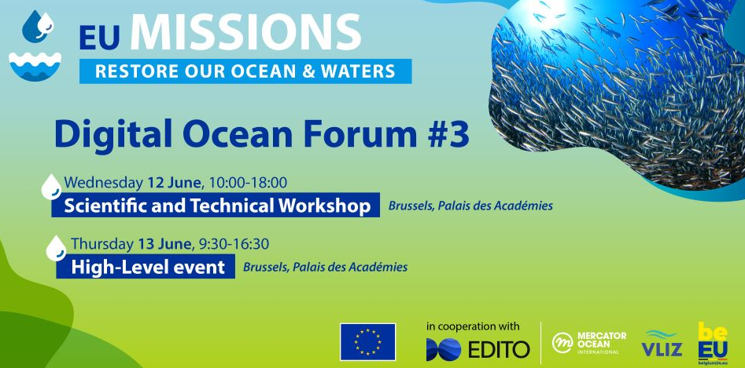
Community-building
Mission Forum and lighthouse conferences
Blue Parks community established
Digital Ocean Forum and DTO community established
Coalition of cities, regions, islands
Regions associated to Mission projects (125 expected after 3 work programmes)

Slide 13
How YOU can contribute to our Mission
Share your views on needs and challenges the Mission can contribute to
Work together to ensure complementarities and convergence of efforts to preserve our seas and freshwaters and support the blue/green transition;
Show political engagement by adhering to the Mission Charter and/or promote submissions to the Charter
Participate in Mission calls and share your results
Promote the involvement of ‘associated regions’ in Mission projects
Join our Mission events!

Slide 14
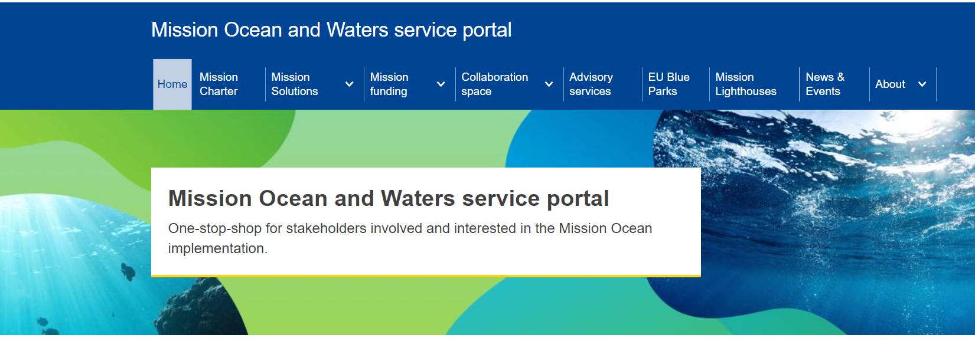
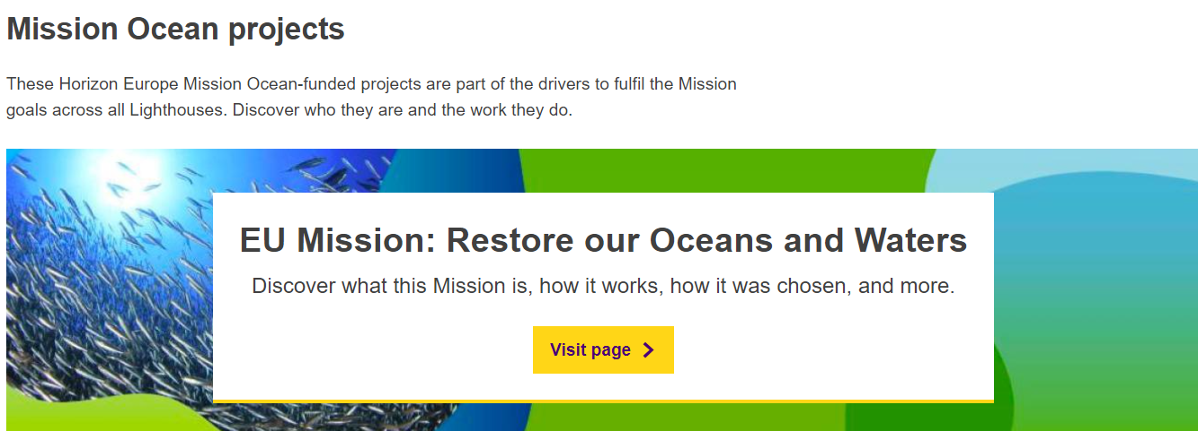
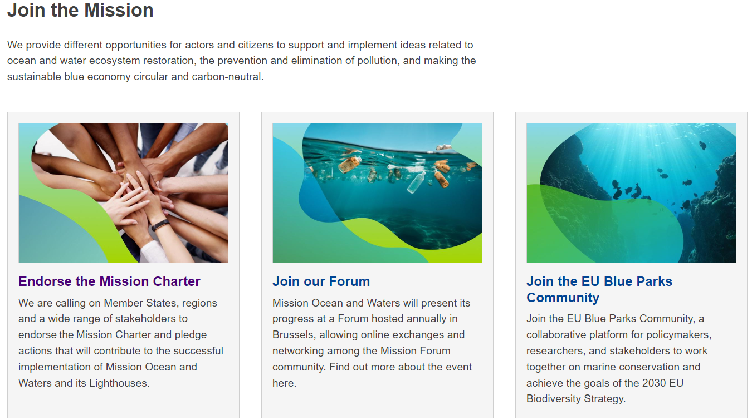
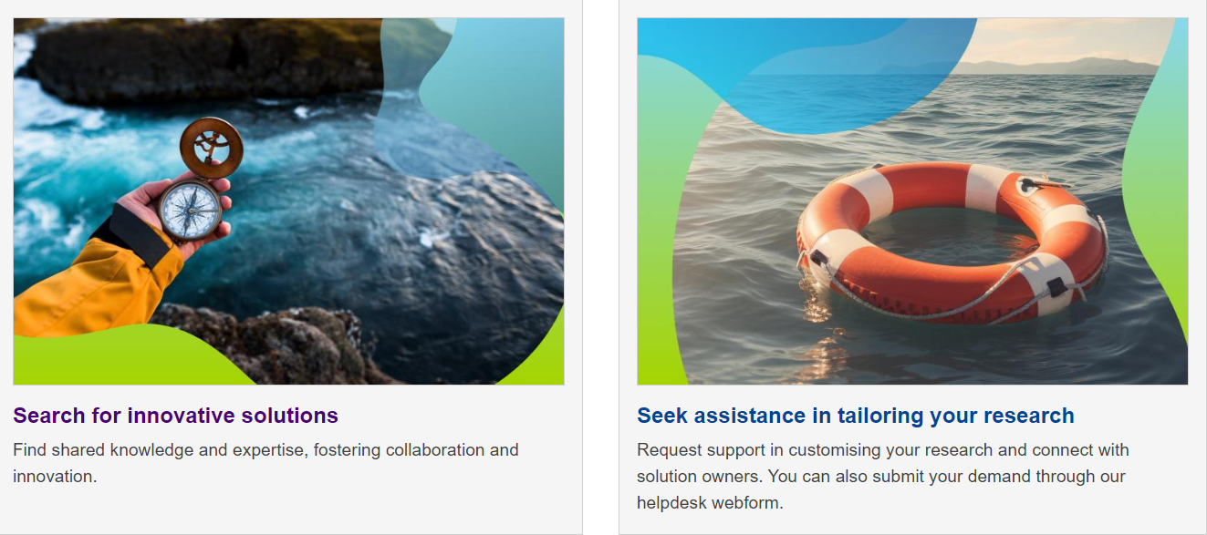
MISSION SERVICE PORTAL

